Slide 1
Unsubsidized Affordable Housing?
Manufactured Housing in Montana
Bridging the Gap - Building Housing Partnerships
June 10, 2015
Doug Ryan, Director Affordable Homeownership

Slide 2
WHAT is I’M HOME?
Why?
When homeowners lack the following, their homes often become depreciating assets:
An initiative designed
to ensure that families who purchase manufactured homes are able to build wealth through homeownership
Good home & installation quality
Long-term control over land beneath one’s home
Safe, high-quality mortgage products
Equitable public policies

Slide 3
What Does I’M HOME Do?
I’M HOME started out by providing funding, technical assistance and field building support to programs doing the following activities
1
2
New & Replacement Development
Community Preservation & Improvement
Mortgage Financing
Public Policy
3
4

Slide 4
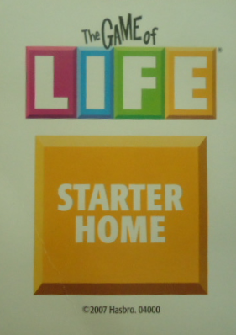
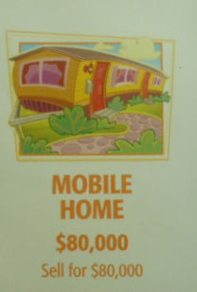
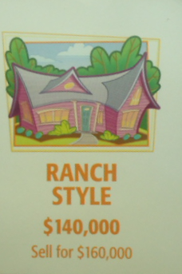
WHY MANUFACTURED HOMES?

Slide 5
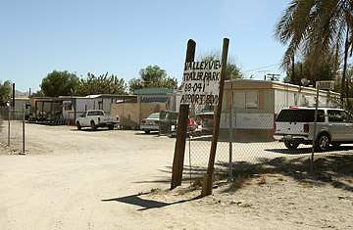
How Too Many Homes Look Today

Slide 6
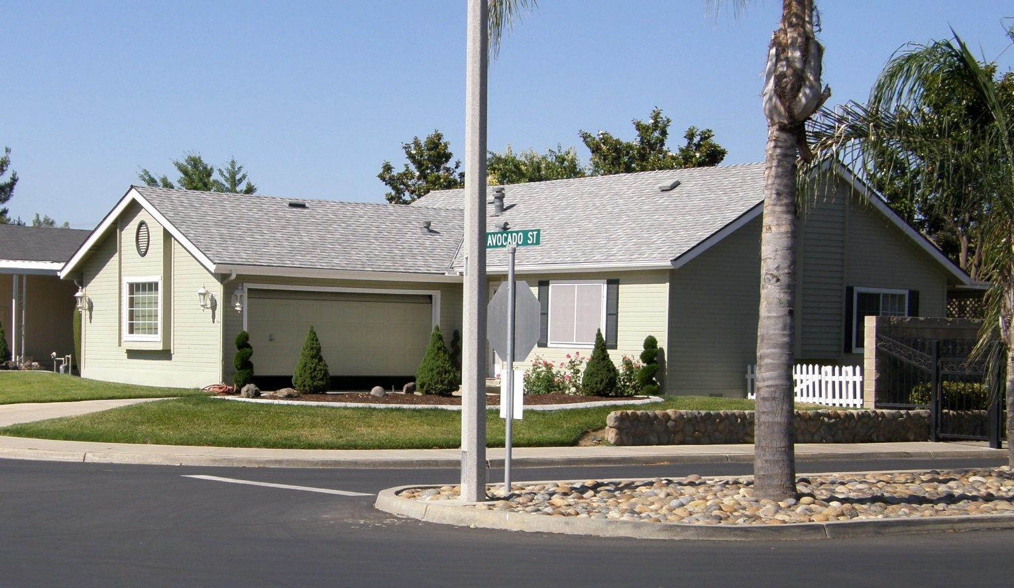
How They Can Look Today

Slide 7
Manufactured Housing in Montana
Over 53,000 units
11-12% of state’s housing (38% in Broadwater County)
Just 8% in “unacceptable condition”
950 + manufactured home communities
Manufactured home values typically rise

Slide 8
Key Public Policy Areas
Finalize Duty to Serve rules for the GSEs
Unfair lending bill in Congress: HR 650/ S 682
Very good state law on resident rights, lending, weatherization and tax incentives for preservation
Tilting reform is needed in Montana
Notes:
RD
State HFA

Slide 9
Please contact:
Doug Ryan, Director Affordable Homeownership
CFED
202-207-0155
dryan@cfed.org

