Slide 1
NeighborWorks Montana
Housing Counseling and Home Buyer Education in Montana

Slide 2
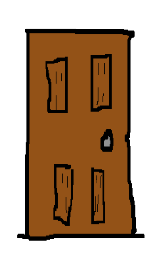
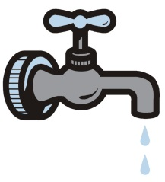
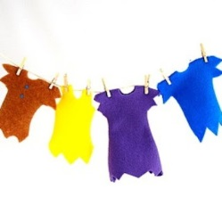
What Will you do?
The Baby is Crying
Someone is knocking at the door
The water in the sink is running
The phone is ringing
Laundry is drying on the line and it’s about to rain.

Slide 3
Montana Homeownership Network:
NeighborWorks Montana | Montana Board of Housing
NorthCentral RC&D | Headwaters RC&D
NeighborWorks Great Falls | Homeword
Rural Dynamics, Inc. | Bitterroot RC&D
Rocky Mountain Development Corporation | Community Action Partnership of Northwest Montana
Snowy Mountain development corporation | Human Resource Development Council, District 9
Salish Kootenai Tribal Housing Authority | Northern Cheyenne Tribal Housing Authority
Human Resource Development Council, District 7 | Human Resource Development Council, District 11
Human Resource Development Council, District 7 | Human Resource Development Council, District 11

Slide 4
NeighborWorks Center for Homeownership Education and Counseling Certification Tracks
Homebuyer Education
Foreclosure Intervention and Default Counseling
Homeownership Counseling
Financial Capabilities

Slide 5
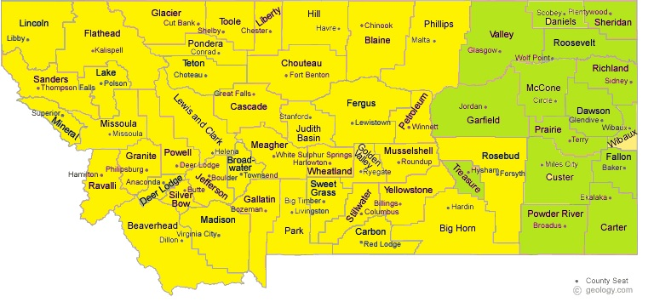
Pre-Purchase Counseling

Slide 6
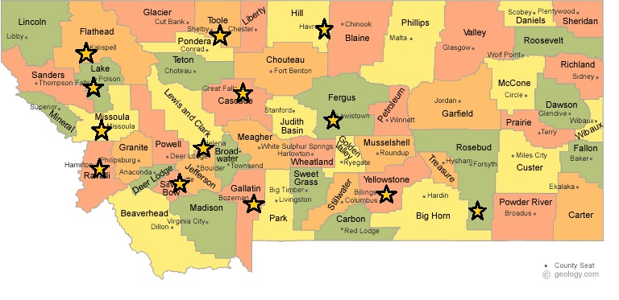
Home Buyer Education

Slide 7
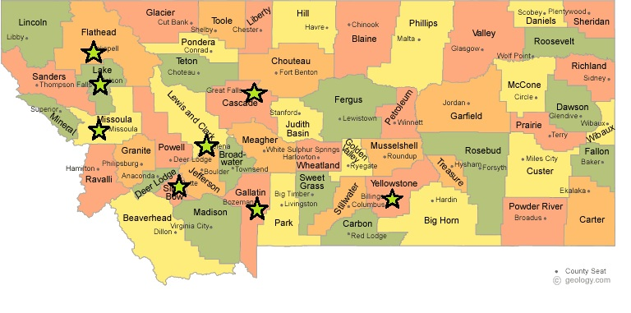
Foreclosure Intervention

Slide 8
Curriculum Requirements
Assessing Homeownership readiness
Budgeting and credit
Financing a Home
Shopping for a Home

Slide 9
In 2014 MHN Partners Helped:
1559 Homebuyer Education Participants
135 Financial Education Participants
1145 Pre-Purchase Counseling Customers
363 Foreclosure Mitigation and Default Counseling Customers

