Slide 1
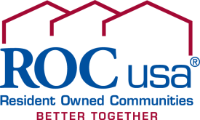
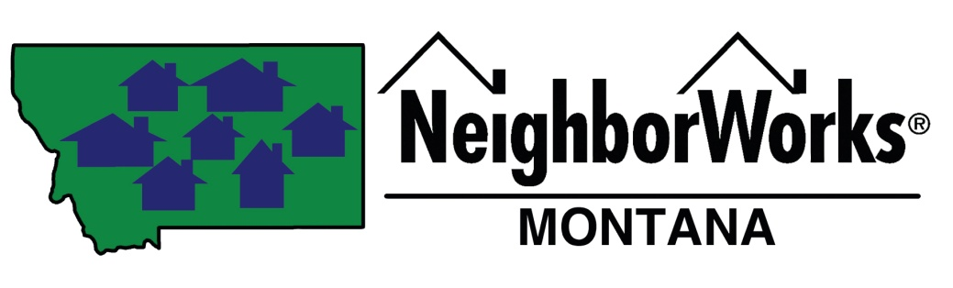
Kaia Peterson, NeighborWorks Montana
Resident-Ownership
Preservation of Affordable Housing

Slide 2
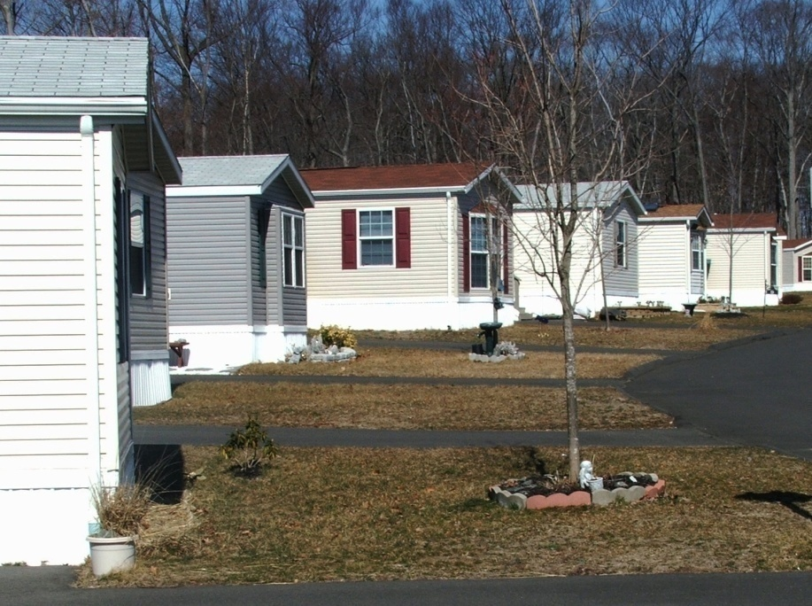
The Status Quo
Notes:
35% of MH in Montana are in MHCs
Homeownership in stick built is about 68%
Status Quo is Investor-Owned Model:
Individuals who live in manufactured home communities own their homes but do not control their land
Housing at risk
Housing affordability at risk
Lack security for investment
Manufactured Home Communities = Trailer Parks
Both homeowners and financial institutions lack security for investment
Build a deck, but if move lose that investment
Lenders lack security – homes are mobile, risk displacement
Without ownership of land, manufactured homeowners can’t enjoy the full benefits of homeownership. They don’t have security – the land can be sold out from under them, they can’t realize appreciation, can’t access single-family financing; are often treated as second-class citizens.

Slide 3
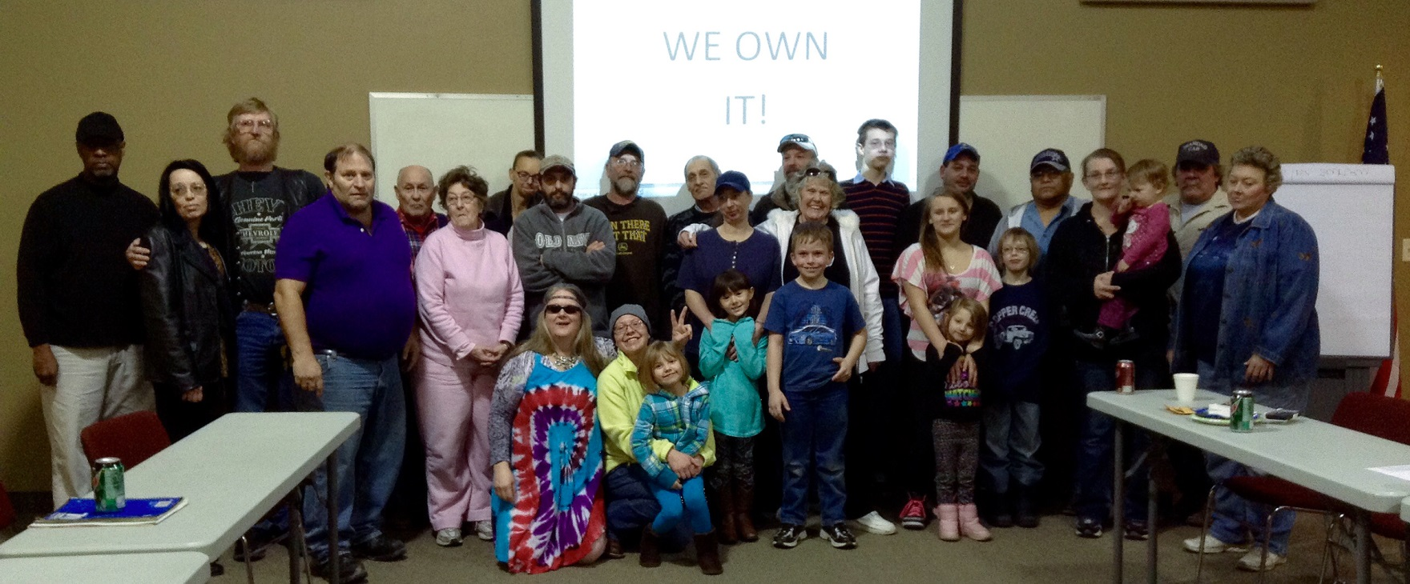
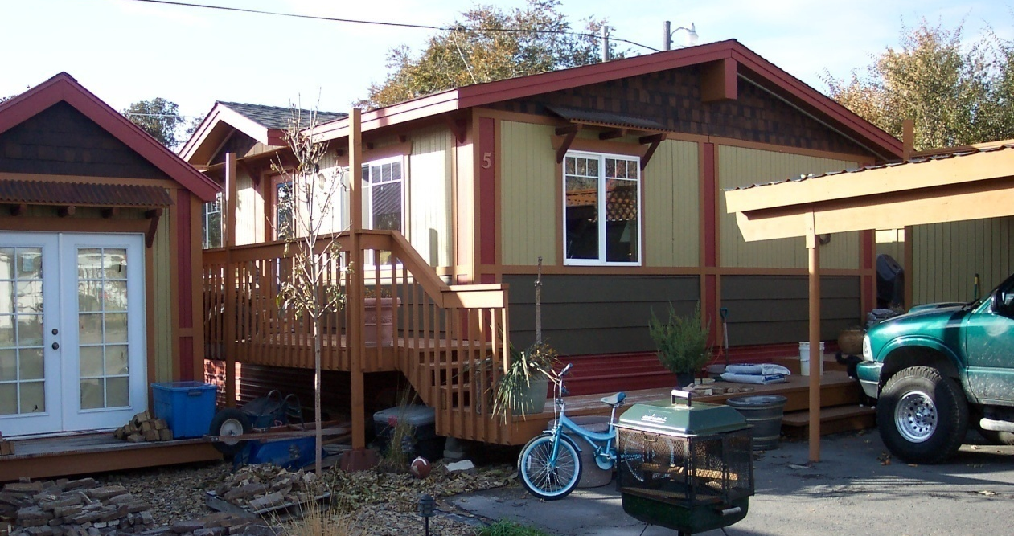
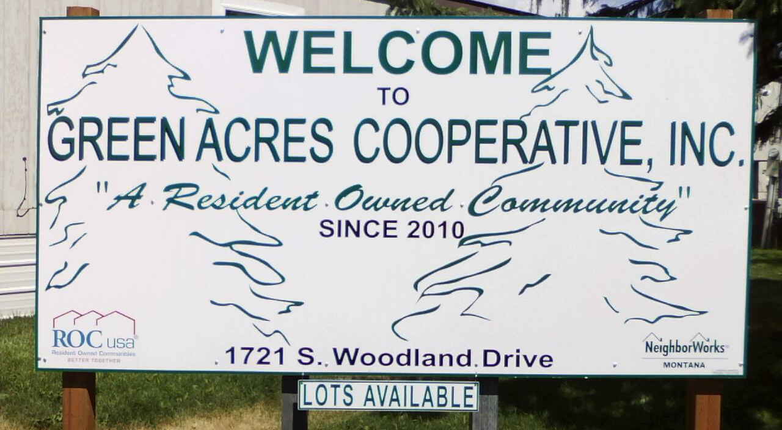
Resident-Ownership
Notes:
Homeowners form a limited-equity non-profit corporation
Governed by democratic principles
Co-op members pay one-time membership fee
Lot rents support community expenses and debt payments
ROC USA Goals:
Preserve and improve affordable communities;
Build individual assets;
Foster healthy, mutually-supportive communities and community leaders.

Slide 4
ROCs in Montana
  7 Communities – 295 Households
  $8 MM in acquisition financing
Notes:
Started on MSV in 2009 – became resident-owned in 2012. First resident-owned was Green Acres in 2011. Supporting about 2 new communities each year.
Green Acres, Kalispell
Mountain Springs Villa, Red Lodge
Missouri Meadows & Trailer Terrace, Great Falls
Buena Vista & River Acres, Missoula
Northwood Community, Pablo

Slide 5
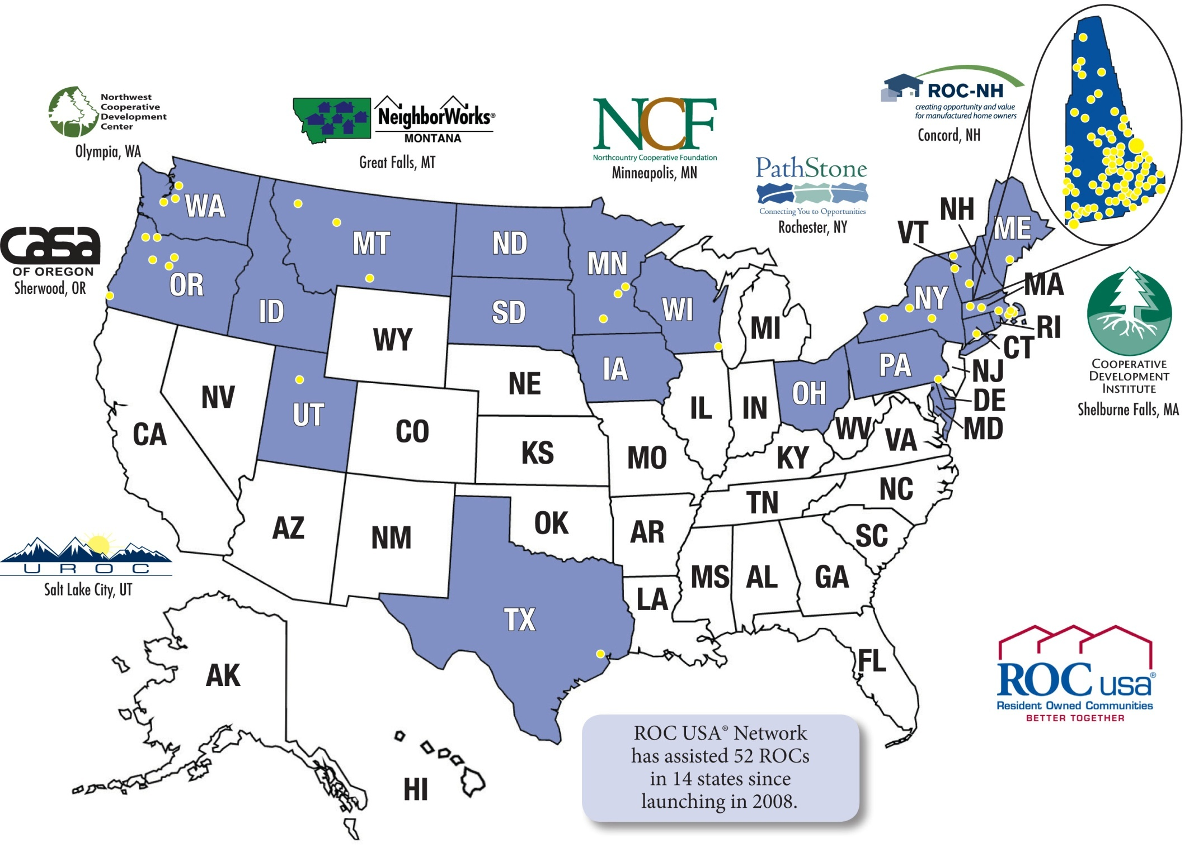
ROC USA Network
  170 Communities – 14 States – 10,000 Homes – $300 MM in Financing
Notes:
- Since NH helped that first group of residents purchase, back in 1983
161 community purchases
Represent 9,229 homes in 14 states and almost 300 million in MHC financing
Our long-term ROC success rate is 100%

Slide 6
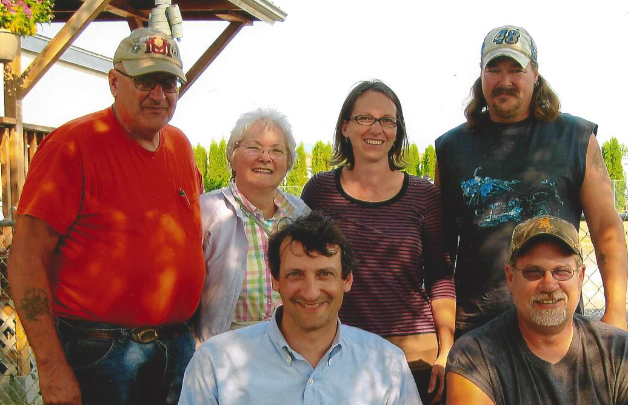
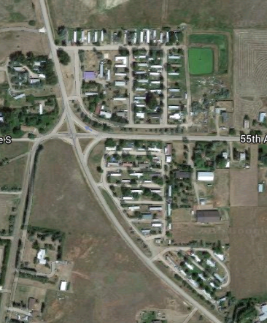
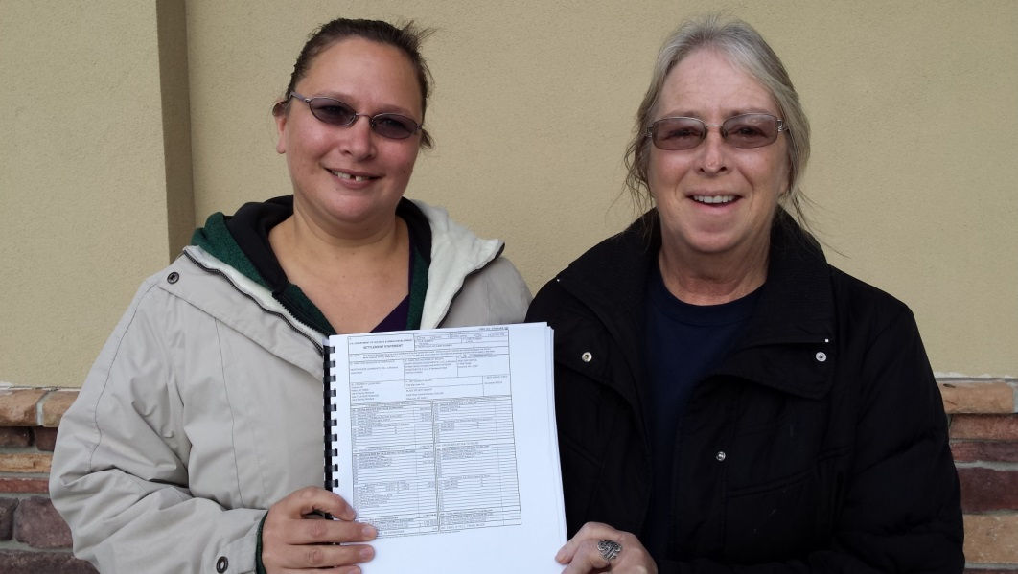
Acquisition
Notes:
Willing seller
Technical support from NeighborWorks Montana
Residents form Co-op
Evaluate opportunity to purchase
Financing from ROC USA

Slide 7
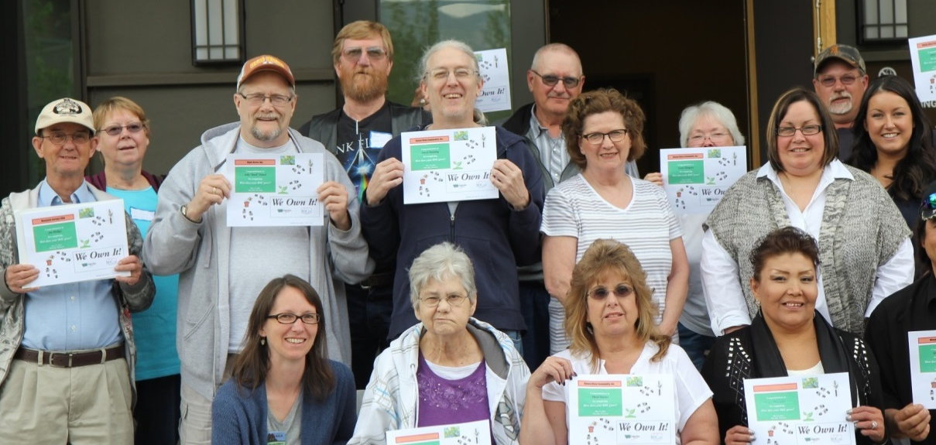
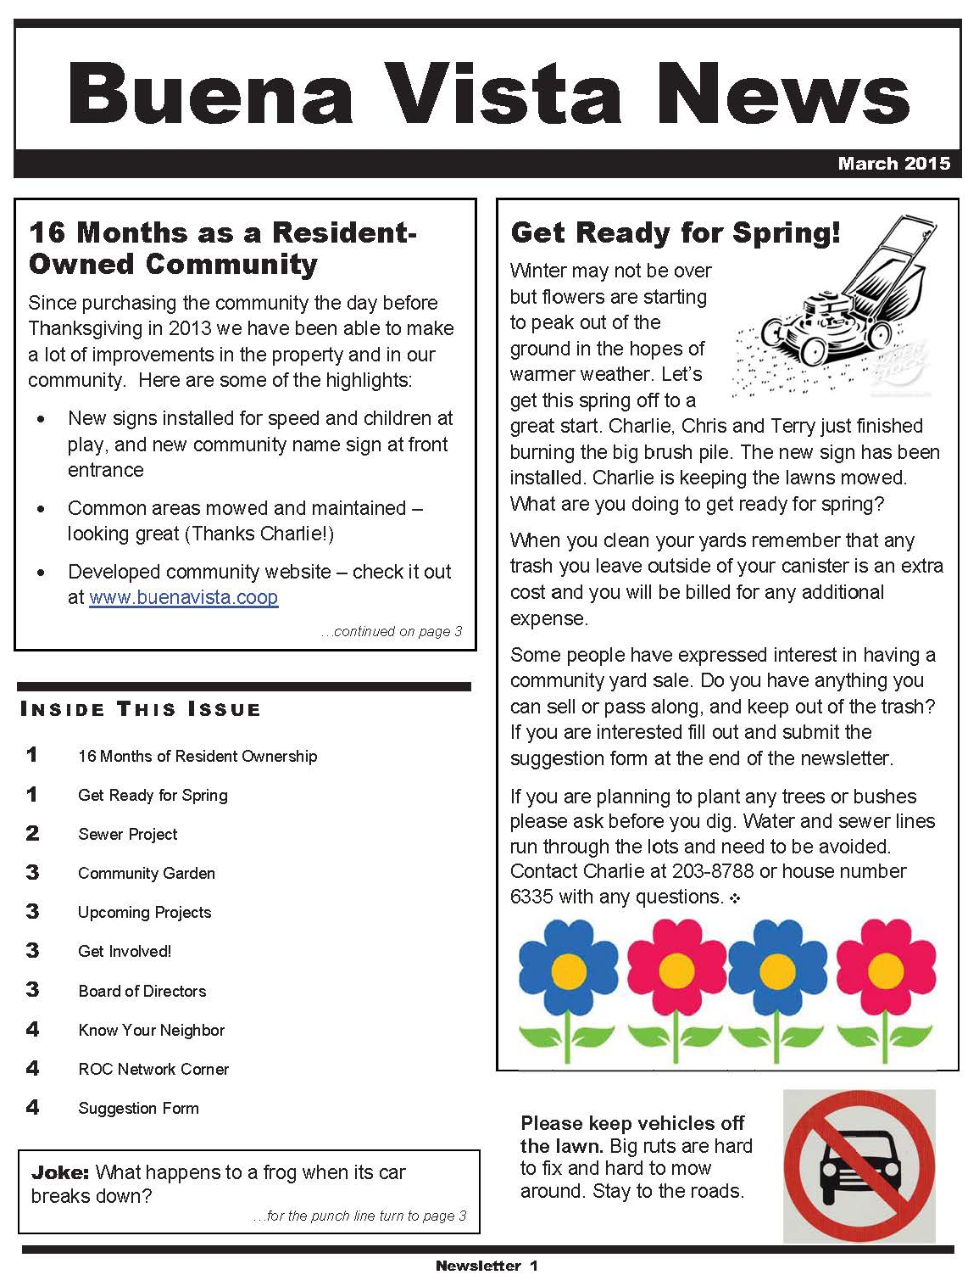
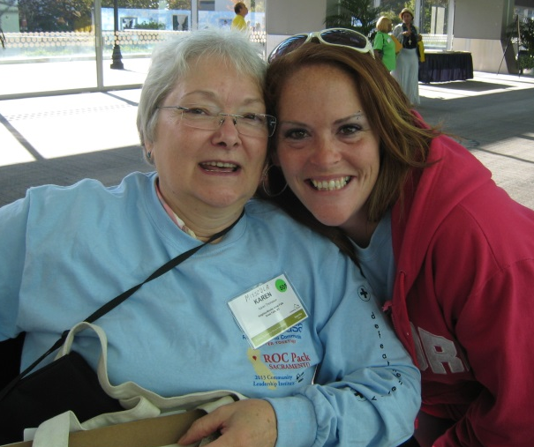
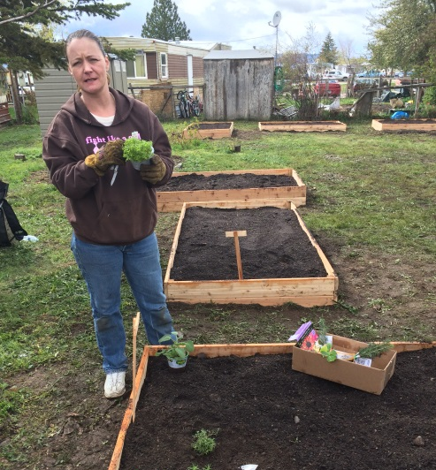
Training and Community Engagement
Notes:
Board and Member Training
Running good meetings, understanding and managing co-op financials, understanding corporate documents (bylaws, articles of incorporation)
Community Leadership Institute
Ongoing support – NWMT attend board meetings and on-call for board questions, review financials
Community Engagement
VISTA volunteer
Community projects, committees (social committee), leadership succession, resident support
Infrastructure
Green Acres connecting to city sewer
Major infrastructure needs are not uncommon in trailer parks
Montana unique in the ROC network – lots of state funding available for infrastructure projects
Home Replacement
Next step is to replace old homes. Once perpetual land lease is established creates more opportunity for financing and home replacement.
More affordable home lending is an important part of making replacement affordable.
Weatherization and repair programs can be a good option for some homes.

Slide 8
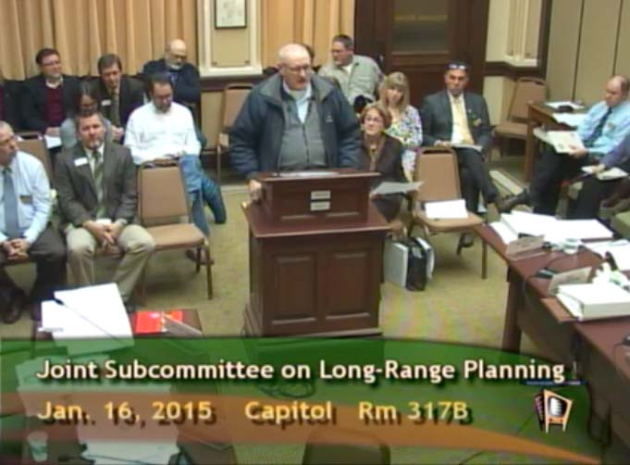
Infrastructure Development
Notes:
Board and Member Training
Running good meetings, understanding and managing co-op financials, understanding corporate documents (bylaws, articles of incorporation)
Community Leadership Institute
Ongoing support – NWMT attend board meetings and on-call for board questions, review financials
Community Engagement
VISTA volunteer
Community projects, committees (social committee), leadership succession, resident support
Infrastructure
Green Acres connecting to city sewer
Major infrastructure needs are not uncommon in trailer parks
Montana unique in the ROC network – lots of state funding available for infrastructure projects
Home Replacement
Next step is to replace old homes. Once perpetual land lease is established creates more opportunity for financing and home replacement.
More affordable home lending is an important part of making replacement affordable.
Weatherization and repair programs can be a good option for some homes.

Slide 9
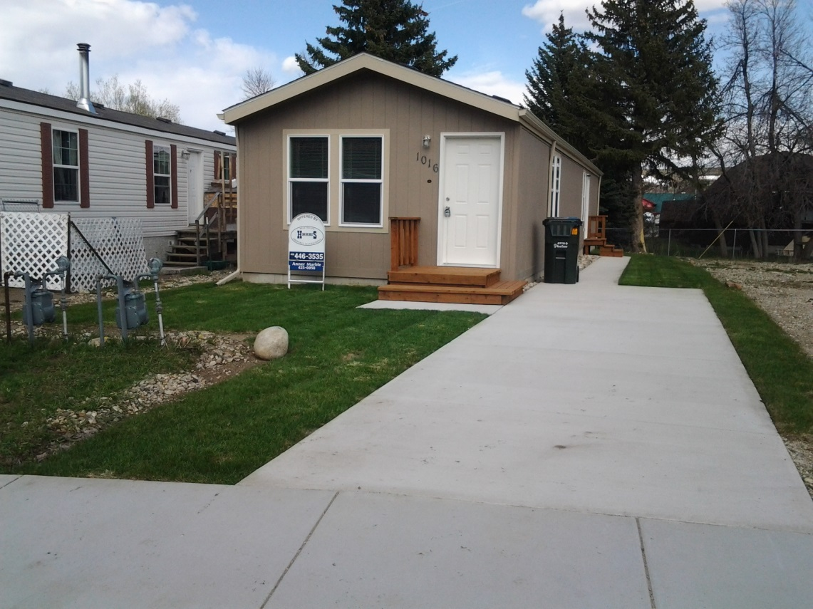
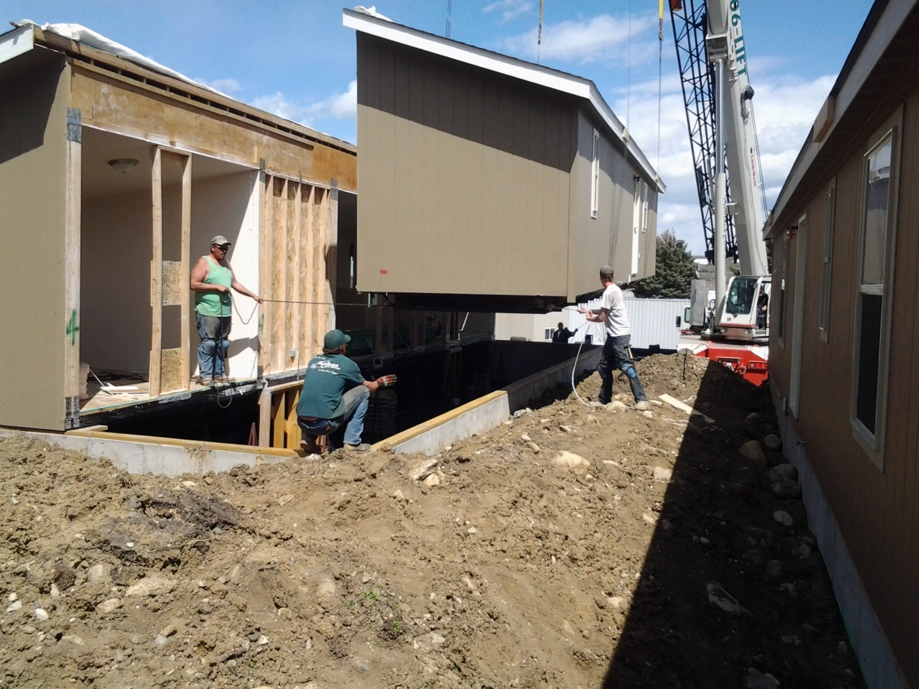
Home Replacement
9
Notes:
Next step is to replace old homes. Once perpetual land lease is established creates more opportunity for financing and home replacement.
More affordable home lending is an important part of making replacement affordable.
Weatherization and repair programs can be a good option for some homes.

Slide 10
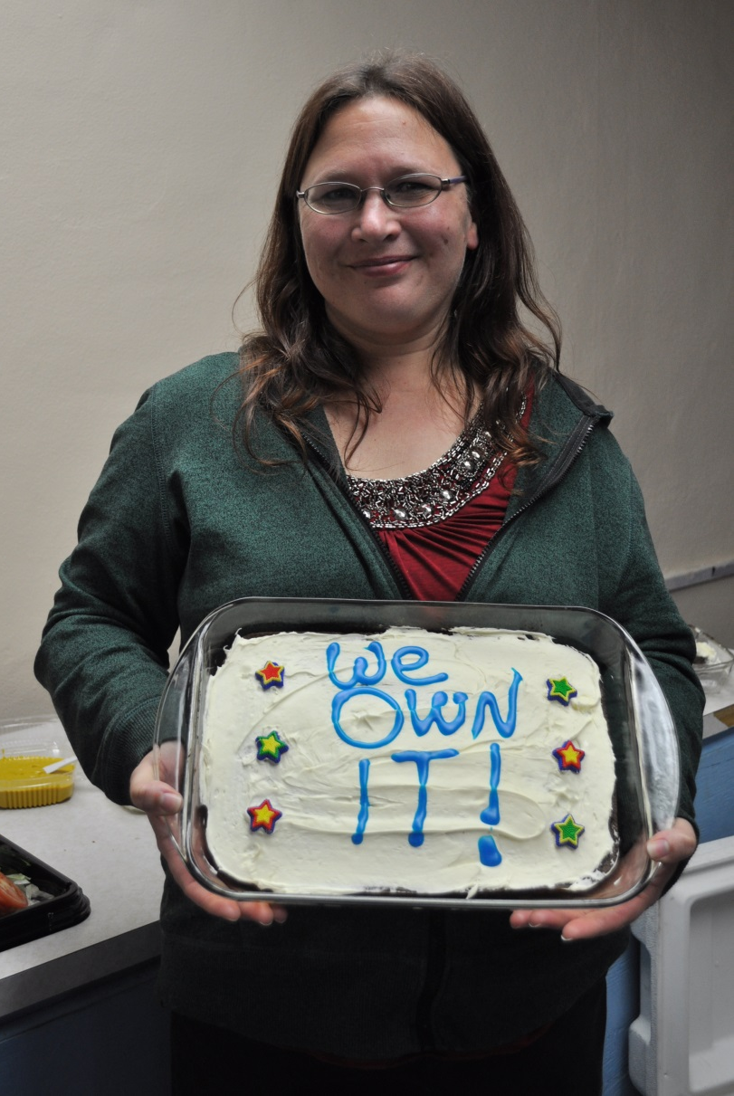
Resident-Ownership Impacts
Housing Stability
Housing Affordability
Leadership Development
Building Community
Individual Asset Building

Slide 11
Kaia Peterson, NeighborWorks Montana kpeterson@nwmt.org
406-531-3449
If you are ready to sell,
we are ready to ROC!

Slide 12
Montana ROC Financing
 |  | TOTAL
Sources
 | ROC USA | 5,680,500 | 71%
 | NWMT | 1,219,303 | 15%
 | Other Loans/Grants/Equity | 1,072,307 | 13%
TOTAL |  | 7,972,110
Uses
 | Purchase Price | 6,419,000 | 81%
 | Acquisition Costs | 479,505 | 6%
 | Infrastructure | 786,400 | 10%
 | Reserves | 287,206 | 4%
TOTAL |  | 7,972,111
  7 Communities
  295 Homes
  $8 MM in Acquisition Financing
Notes:
NW – MT has a track record, with two more in the pipeline

Slide 13
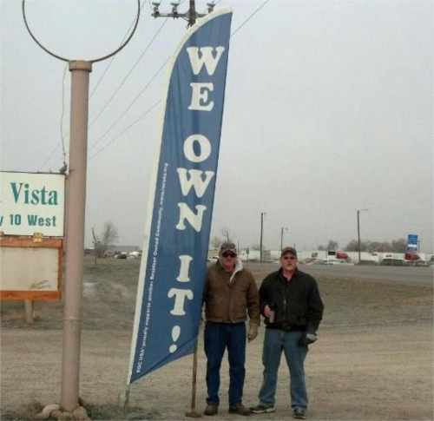
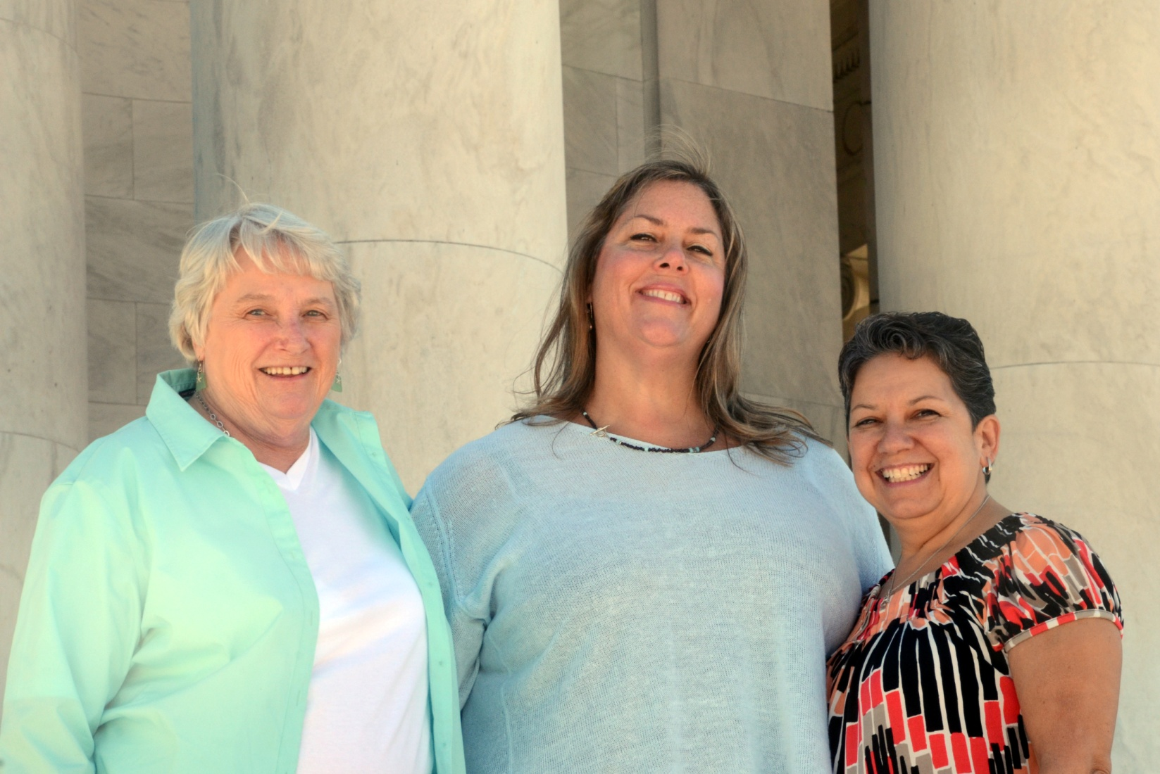
ROC as Innovator
myROCUSA.org
ROC Co-op Marketing Program
Community Grants
Cooperative Purchasing
ROC Association
Notes:
One thing I love about being part of ROC is that they are innovative in trying to create benefits for the residents they work with and they really work to incorporate cooperative principles across their work. Walking the walk.
MyROCUSA – share, video trainings, document templates
Marketing – brochure and website for each co-op
Purchasing
ROC Association – elected representative from three districts serve on the ROC USA board of directors

Slide 14
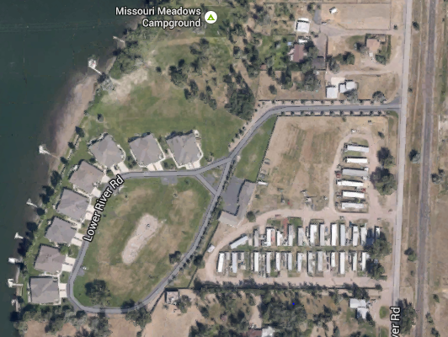
Missouri Meadows
Replacement homes?? Evictions??
The RV and fill solutions
Life in the Flood Plain

Slide 15
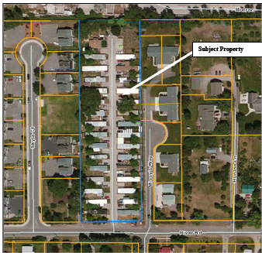
Yippee!! City Water and Sewer
River Road

Slide 16
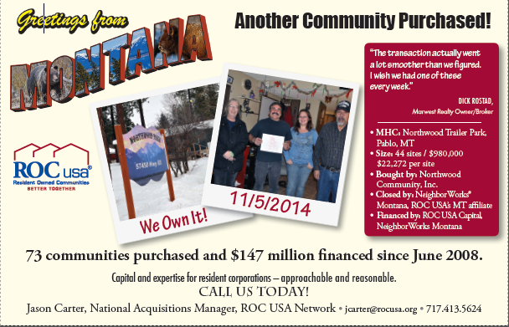
Northwood Community
Collaboration with
Salish-Kootenai Housing Authority
First ROC on Reservation

Slide 17
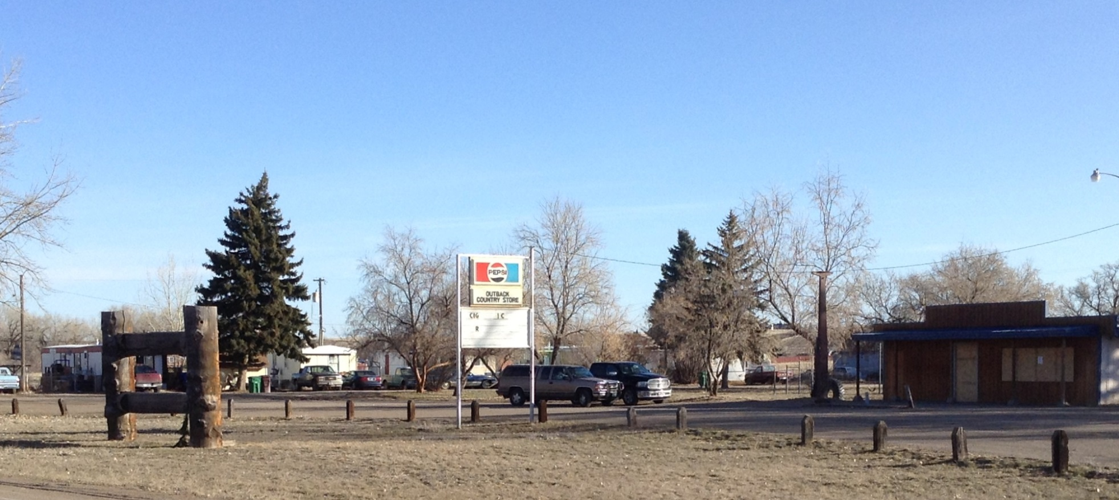
Biggest ROC Trailer Terrace
$1.3 Million purchase
$3.7 million water and sewer repairs
Water and sewer district
Population larger than 29 incorporated Montana towns

Slide 20
Sample ROC - Acquisition
Number of Sites | 35
Membership Fee | 250
Acquisition Budget: |  | Per Site
Purchase Price | $800,000 | $ 22,857
ROC USA Capital - Origination Fee (.75%) | $6,600
NWMT Loan - Origination Fee (1.00%) | $653
CTAP Fee (2.75%) | $22,000
Title Insurance | $2,200
Recording & Other Closing Costs | $1,600
Lender's Legal Fees | $9,000
Borrower's Legal Fees | $4,000
Appraisal | $4,000
Environmental Site Assessment | $4,500
Property Conditions Report | $14,500
Accrued Interest on Pre-Dev. Loan | $745
Property Tax Abatement Reserve | $25,000
Insurance Premium - First Year | $3,750
Debt Service Reserve (1 month debt service) | $6,080
Working Capital Reserve (1.5 months operating expense) | $7,375
Replacement Reserve | $12,000
Priority Repairs | $25,000
Infrastructure Development | $150,000
Total Financing Needed: | $1,099,003 | $31,400
Financing Package: |  | Monthly
ROC USA Capital (1st Mortgage Loan - 6.0%, 30 yr amo, 10 yr term) | $880,000 | $5,276
NWMT Loan (2nd Loan - 5.0%, 30 yr amo, 10 yr term) | $65,253 | $350
Infrastructure Grants | $150,000 | $0
Membership Fees - Equity | $3,750 | -
Total: | $1,099,003 | $5,626

Slide 21
Sample ROC - Operating
Operating Expenses: |  | Per Home
RE Taxes | $8,400 | $240
Electricity/Utilities | $2,300 | $66
Financial Statement Audit / Tax Prep. | $3,500 | $100
Insurance (CGL / Bond / Property) | $3,750 | $107
Legal | $2,000 | $57
Office Supplies & Expenses & Licensing | $550 | $16
Repairs and Other Maintenance | $8,000 | $229
Exterior Lot Maintenance (4% of EGI) | $5,250 | $150
Property Management (6% of EGI) | $7,750 | $221
Water/Sewer | $2,000 | $57
Trash Collection | $11,500 | $329
Replacement Reserve | $4,000 | $114
Total Annual Operating Expenses / Per Home: | $59,000 | $1,686
Total Annual Operating Expenses % of income |  | 45.50%
Revenue:
Lease Fee per month | $325
Number Of Sites | 35
Gross Monthly Income | $11,375
Less: Vacancy/Rent Loss (5.0%) | -$570
Gross Effective Monthly Income: | $10,805
Annual Cash Flow Analysis:
Gross Effective Annual Income | $129,660
Less: Operating Expenses | $59,000
Net Income Available for Debt Service-ROC Capital | $70,660
Less: Debt Service-ROC Capital | $63,313 | DCR 1.12
Net Income Available for Debt Service-NWMT | $7,347
Less: Debt Service-NWMT | $4,203 | DCR 1.06
Net Surplus: | $3,144

