Slide 1



MBOH Habitat Loan Essentials

Slide 2

MBOH’s Mission:
Create affordable housing opportunities for Montana’s families and communities whose needs are not met by the market.
Notes:
To Create affordable housing opportunities for Montanans whose needs are not met by the market.
To collaborate with our partners to make sure Montana’s families and communities have attainable, affordable, accessible and sustainable homes.

Slide 3
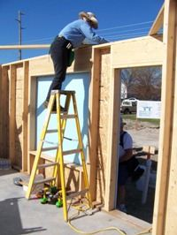
Habitat for Humanity
Mission: To transform the lives of local families by building simple, quality, affordable homes.
Notes:
MBOH works with Habitat for Humanity in chapters across the state to provide first mortgages for Habitat homeowners who credit-qualify for a loan.
By providing financing for these mortgages, MBOH allows Habitat to receive the cash when the family moves in, providing resources to purchase land and materials for another family.

Slide 4

Blend of Habitat and MBOH Objectives:
Habitat borrower qualifies for loan amount at 0% interest
MBOH makes loan at 2%
Notes:
Habitat borrower qualifies for a loan amount at 9% interest to meet Habitat guidelines.
MBOH makes loan at 2% to enable Habitat to finance a loan at the highest level of subsidy it can provide.

Slide 5

Eligibilities

Slide 6



Mortgage ready?
Credit Worthy?
Notes:
The main objective to keep in mind is whether a borrower or borrowers are ready for a mortgage and are they credit worthy for a mortgage loan.

Slide 7



Borrower Eligibility Criteria:
Fall under income limits (*Habitat criteria)
      A first-time homebuyer
            Plan to occupy residence
            No asset limitations
            Taken Homebuyer Education Class
Notes:
*Income limits are based on Habitat Criteria
*First Time Homebuyer can be waived for targeted areas depending upon Habitat criteria
*Home must be primary residence as long as the loan remains in place

Slide 8
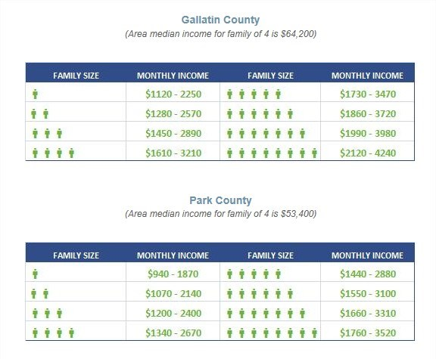
Example of Habitat income limits
Website: http://habitatbozeman.org/get-involved/become-homeowner/qualifications-application
Notes:
Example of income limits for Gallatin Valley area.

Slide 9


Underwriting Criteria:
Underwrite to RD standards
100% LTV
Notes:
In order to qualify a borrower for a Habitat loan, the lender should use the RD underwriting criteria and enter the information assuming 100% LTV with the total value of the property equal to the loan amount, i.e., as if it were 100% financing at the loan amount. MBOH requires that the lender submit a copy of the RD printout in order to validate the qualification of the borrower for the loan.

Slide 10
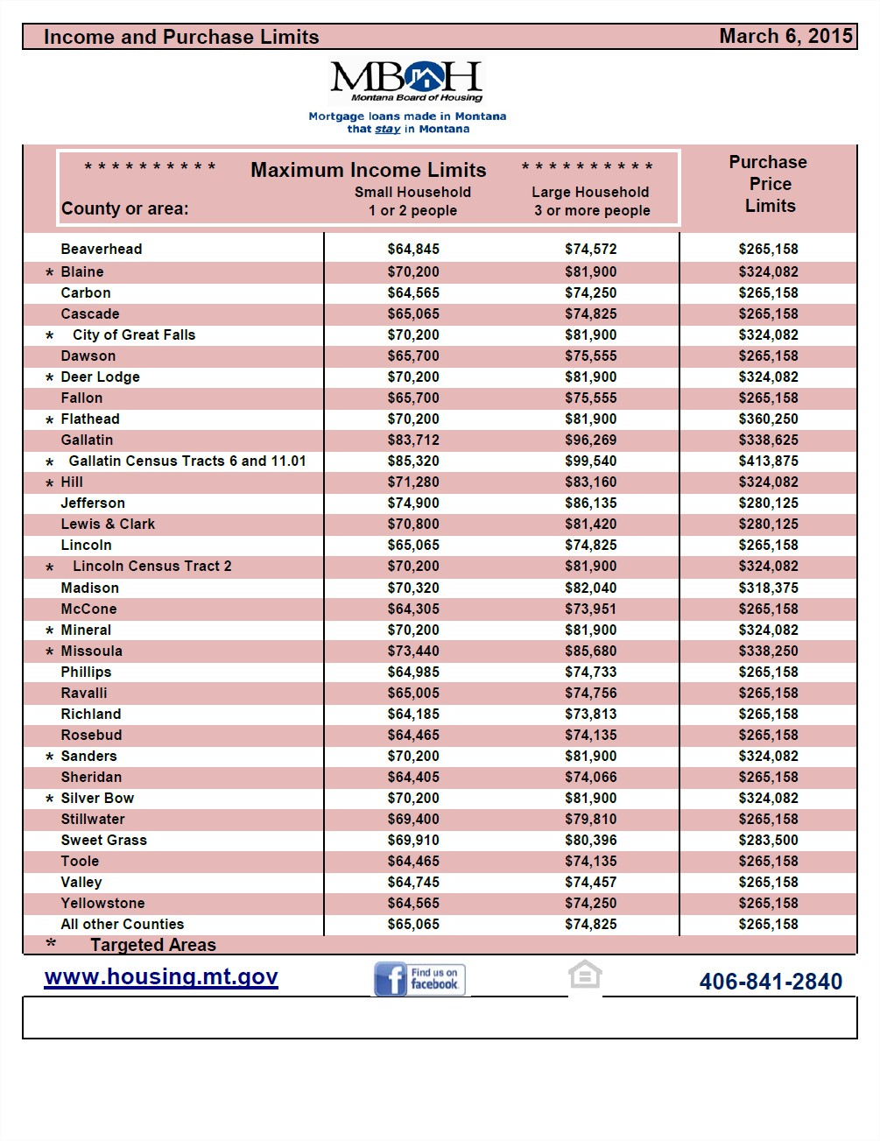
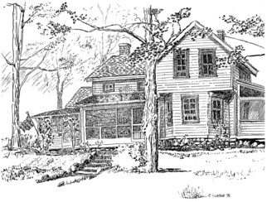
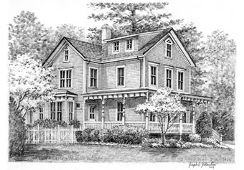
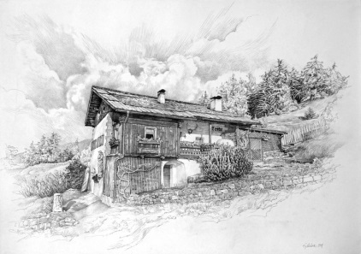
Property Criteria:
Purchase Price Limits
Limit of 15% use of the property for business
Cannot subdivide property (multiple lots)
Applicable state & local building laws
MBOH’s Quick reference Guide can be found at:
http://housing.mt.gov/HBProgDocs#Information-Regulations-Procedures-180
Notes:
Click after Purchase Price Limits

Slide 11



Loan Criteria:
MBOH loan at 2% with Habitat 2nd loan at 0%
      No lender fees allowed
          180 days for reservations
              Escrow is required
                Hazard insurance deductible $1,000 or 1% of dwelling, all perils
Notes:
MBOH=2% loan
Habitat=0% loan
MBOH Purchases at 100%, no lender fees are allowed
180 days reservation – limit for new construction
Hazard Insurance, ALL perils, $1,000 up to 1% of dwelling coverage

Slide 12

Special Reservation Criteria:
Loan reservation is NOT automatic
Lender must submit confirmation letter from Habitat Chapter and qualified loan amount (0%) to MBOH prior to reservation approval.
MBOH calculates and sends lender amounts for MBOH’s first lien and Habitat’s Wrap-around 2nd lien.

Slide 13
Terms and Conditions:
  MBOH + Wrap-around loan together
  are at 80% LTV (or lower)
Habitat 3rd lien loan is at least 20%
of the appraised value = 100%
  (Meets MBOH’s criteria for a loan without mortgage insurance)
80%
100%
20%

Slide 14

Terms & Conditi0ns CONT……
Fits Profile of regular MBOH loan:
  Income Limit
  Purchase Price Limit
  First Time Homebuyer
  Residence Requirement
  New Mortgage Requirement
  Assumptions
  Recapture Tax does NOT apply to Habitat loans
  Mortgage Purchase and Servicing Guide can be found at:
  http://housing.mt.gov/Portals/93/shared/docs/Homebuyers/ProgramDocuments/InfoRegsProcedures/purchaseguide.pdf
Notes:
Loans under the Mortgage Revenue Bond have to meet the profile of a regular MBOH loan, also known as the seven IRS requirements: ~
Income limit
The Board establishes income limits for each program, based on the Internal Revenue Code of 1986, as amended. Lenders need to refer to each individual program’s documents for Gross Annual Income Limits.
Purchase price limit
The Acquisition Cost of each Residence secured by a Mortgage Loan must not exceed the purchase price requirement for the county in which the Residence is located. The Board reserves the right to revise the purchase price requirement from time to time to reflect more recent statistical information or changes in federal “safe harbor” figures.
First-time buyer (three year rule)
Except for Residences located in Targeted Areas and except for Mortgage Loans made to a Qualified Veterans, the Mortgagor and any other adult intending to live in the Residence must have had no present ownership interest in a principal Residence at any time during the three-year period prior to the date on which the Mortgage Loan is executed. In the event that there is more than one Mortgagor with respect to a particular Residence, each of such Mortgagors must meet the three-year requirement.
Residence Requirement
Intent to use residence as principal residence within 60 days after financing
No more than 15% of residence can be used for business use
Residence cannot be used as an investment property or a recreational home
Only land necessary to maintain basic livability of the residence. If there are multiple lots involved, plat or map must be submitted to show all lots needed for basic livability.
New mortgage requirement
Mortgage Loan must be made to borrowers who have not had a Mortgage on the Residence at any time prior to the execution of the Mortgage Loan.
Assumptions
Present Board Policy is to consent to assumptions when it is satisfied that the Residence requirement, the three-year requirement, the purchase price requirement, and the income requirement are met by the assumptor.
Potential for recapture tax
Does not apply to Habitat loans
(Section 2.05 of the Guide --- starts on page 11) http://housing.mt.gov/Portals/93/shared/docs/Homebuyers/ProgramDocuments/InfoRegsProcedures/purchaseguide.pdf

Slide 15

Terms and Conditions CONT..…
Servicing fee 0.375%
MBOH contacts Habitat affiliates in case of delinquency.
Acquisition cost = Cost of completing the residence
plus unpaid SID assessments
Habitat retains the first right
of refusal on foreclosure

Slide 16

Terms and Conditions MISC..…
MBOH accepts loan reservations on a loan-by-loan,
first-come, first-served basis.
Habitat Chapters are responsible for coordinating their applications among themselves for equitable distribution
Terms & Conditions can be found at: http://housing.mt.gov/HBHabitat

Slide 17

Lender Reservation Requirements
      Loan Reservation/Confirmation Report (Form 99)
      Copy of executed Loan Application
      Verification of annual household income
      Copy of executed Buy/Sell Agreement
      Program Acceptance Letter from Habitat
      Signed "Release of Financial Information" form
      Borrower Stat Sheet
      Certificate of Homebuyer Education
For program documents, please visit our website at:
http://housing.mt.gov/HBHabitat

Slide 18

LOAN CALCULATION pROCESS:

Slide 19
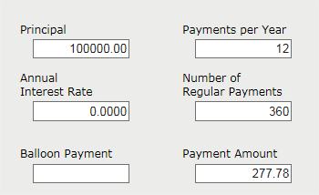
The process part i:
Habitat suggests a qualifying loan amount for borrower based off of the construction cost of the house…
Example: Borrower qualifies for $100,000
Appraisal amount is $125,000
$100,000 @ 0% for 30 years payment: $277.78
Notes:
Borrower is pre-qualified by Habitat @ 0% for 30 years. The qualified amount is usually the construction cost but sometimes smaller at Habitat’s discretion.
Amount must be 80% or less of the appraised value. For our example, 100,000 is 80% of the appraisal amount of 125,000.
For this example:
Borrower qualifies for 100,000
Appraisal is 125,000
100,000 @ 0% for 30 yrs = monthly P&I of 277.78

Slide 20
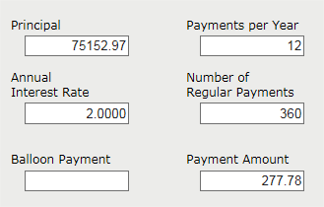
The process part iI::
MBOH calculates the 1st mortgage loan based on the qualified payment amount…
Payment amount borrower qualifies for is $277.78
$277.78 for 30 years @ 2%
MBOH 1st Lien amount is $75,153.00
Notes:
MBOH uses monthly P&I payment from pre-qualified loan ($277.78) to calculate the principal amount for the MBOH loan @ 2% for 30 years in first position.
277.78 @ 2% for 30 years
1st mortgage by MBOH will be 75,153

Slide 21

The process part IIi::
Habitat 2nd Lien (Wrap-Around Loan)
$100,000 - $75,153 = $24,847
(Purchase Price – MBOH loan = 2nd Lien)
Notes:
MBOH calculates second of two loans, the “Habitat wrap-around loan”, as the difference between the lender qualified loan @ 0% for 30 years minus the principal amount of the MBOH loan using $278.78 payments @ 2% for 30 yrs.
100,000 - 75,153 = 24,847

Slide 22
The process part iV::
Habitat 3rd Lien
$125,000 - $100,000 = $25,000
(Appraisal Amount – MBOH + Habitat 2nd = Habitat 3rd Lien)
Notes:
For the Habitat silent 3rd lien, MBOH 1st plus the Habitat 2nd is subtracted from the appraisal amount.
125,000 – 100,000 = 25,000

Slide 23
Pull it all together
MBOH 1st Lien @ 2% $75,153
Habitat 2nd Lien @ 0% $24,847
Habitat 3rd Lien (Silent) $25,000
$125,000 → Appraisal amount
Notes:
To pull it all together, we add the MBOH 1st, Habitat 2nd and Habitat 3rd Silent lien to total the amount of the appraisal.

Slide 24

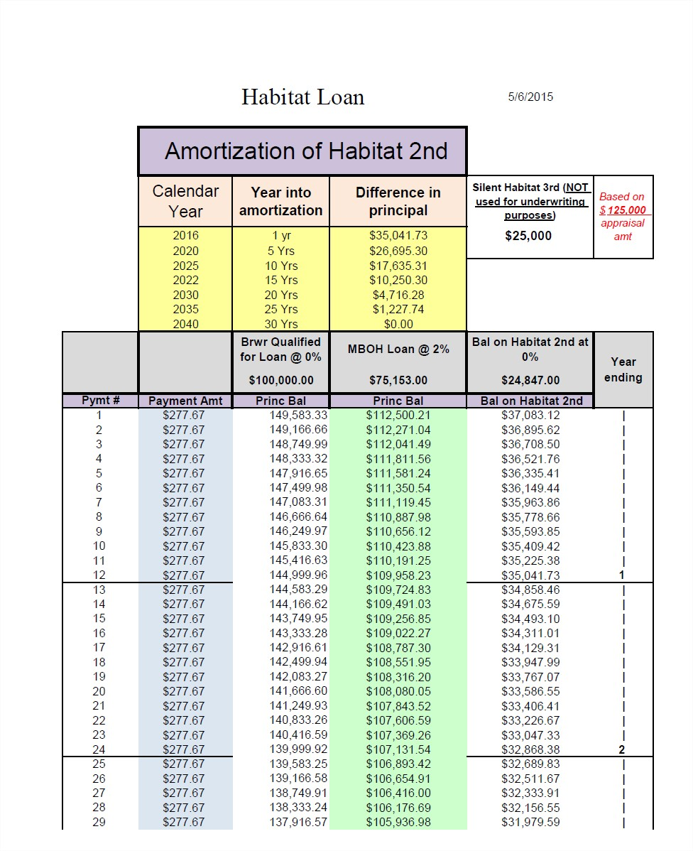
Result of calculations:
MBOH provides the lender with the amortization schedule for the Habitat wrap-around.
Notes:
Using all the calculations from the previous slides, MBOH provides an amortization for the lender. The amortization shows the 3 loans amortizing to a zero amount over 30 years.

Slide 25
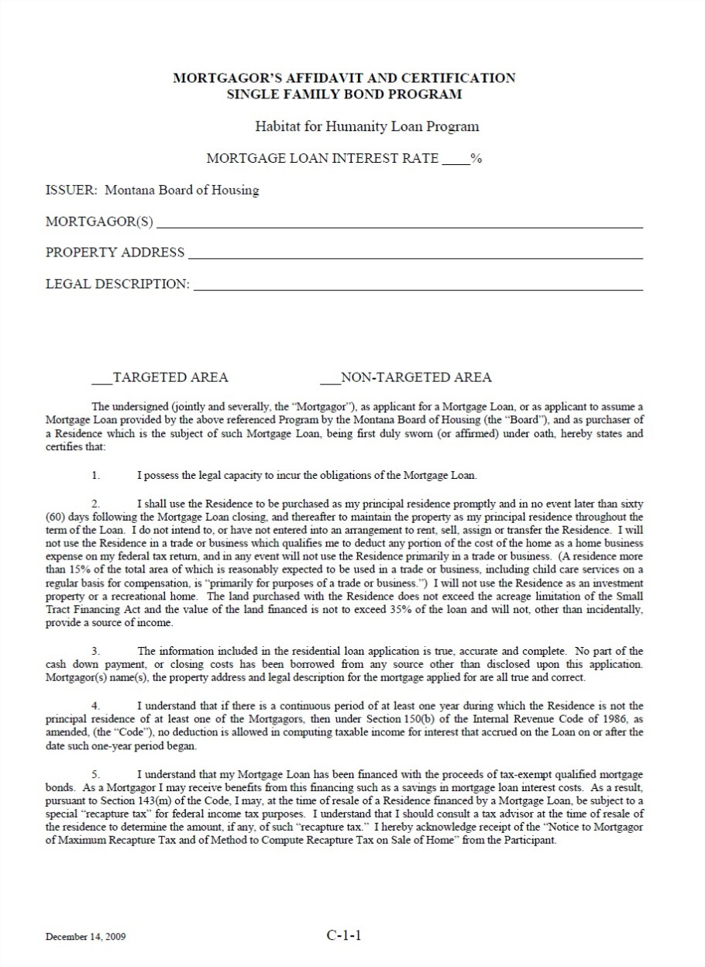
Special Closing Documents:
NOTE: Habitat loans require a specific Mortgagor’s Affidavit at closing.
See Habitat webpage:
Other closing documents for MBOH loans:
http://housing.mt.gov/HBHabitat
http://housing.mt.gov/HBProgDocs

Slide 26

Post closing:
Mortgage Loan purchase package must be tendered for sale to the Board within 30 days following execution of the note by the mortgagor.

Slide 27
Vicki Bauer Program Manager | 841-2849 | vibauer@mt.gov
Charlie Brown Program Supervisor | 841-2850 | chbrown@mt.gov
Julie Hope Reservations, Purchases, Habitat & MCC’s Brandon Whitaker Reservations , Purchases & Liquidation | 841-2853 841-2847 | jhope@mt.gov Bwhitaker @mt.gov
Jeannene Maas Training and Development & MCC’s | 841-2851 | jmaas@mt.gov
Doug Jensen Disabled, Delinquent, Assumptions, Foreclosure | 841-2854 | dojensen@mt.gov
Website www.housing.mt.gov
MBOH Home Ownership Team

Slide 28
?
?
?
?
Q & A

