Slide 1
From Housing Tax Credit to Homeownership
Salish & Kootenai Housing Authority
Rocki Davis, Program Compliance/Development Coordinator
And
Nicole Antoine, Homeownership Coordinator

Slide 2
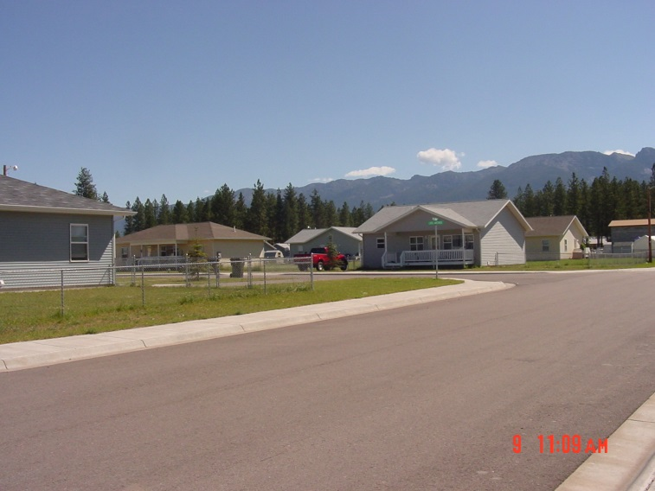
Felsman Addition
Constructed in 1998 using Housing Tax Credits
20 single family units
10 3 bedroom
10 4 bedroom
Fee Simple land
Less than .25 acres
Located on North end of Pablo
Walking distance to all amenities
Rents
3 bedroom $365 + utilities
4 bedroom $ 395 + utilities

Slide 3
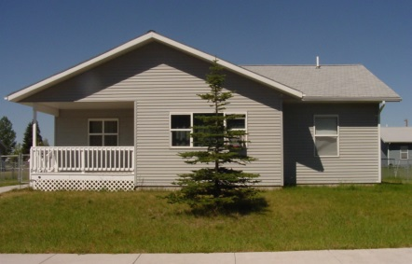
rental Program Qualifications
SKHA Requirements
Past history
Pass background check
Minimum income $20,000
HTC income requirements
8 household could be at 60% local AMI
Family size 4 max income was $ 34,860 (2014 AMI limits)
12 households could be at 50% local AMI
Family size 4 max income was $ 29,050 (2014 AMI limits)

Slide 4
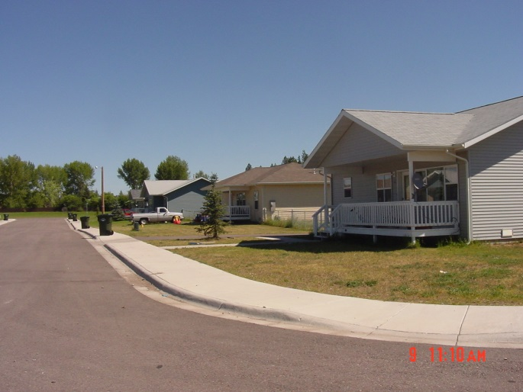
Homeownership program
Complete Application process
Credit report review
Complete credit repair
Mortgage ready by 2014
Complete homebuyer education

Slide 5
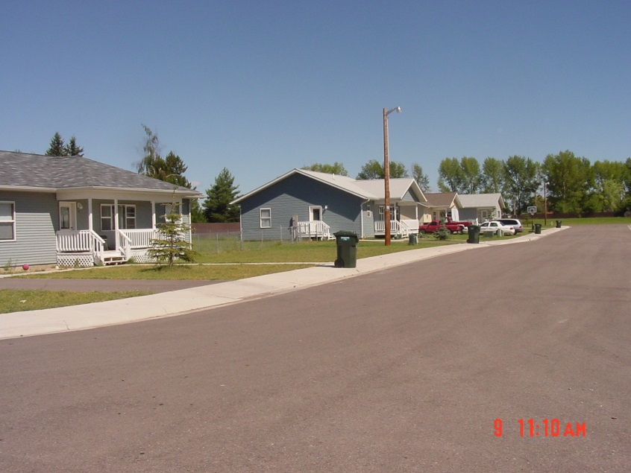
Rental Lease agreement
Tenants entered into 6 month lease agreement
Homeownership clause
Minimum income
Work with homeownership program
If tenant choose not purchase
Tenant priority for SKHA rental

Slide 6
Housing tax Credit Year 15 Decisions
HTC program
Extended Use Agreement
Income
Rent
How to release the extended use agreement (LURA)
Transfer ownership of homes from LP to SKHA
Legal Review
Accounts
Create lighting district (Street lights)

Slide 7
Restrictions
HTC
Remain affordable for 15 additional years
How would it affect the sale?
SKHA
Restrictive Lien Agreement
Equity in property treated as a subsidy
Repayment of subsidy if sold/refinanced in 5 years
Percentage forgiven each year

Slide 8
Lenders
Community Bank – 10
MBOH 1st homebuyers – 9
HUD 184 program – 9
VA – 1
Eagle Bank – 1
HUD 184 program 1
Valley Bank – 2 pending
Tribal Credit program - 7

Slide 9
Loan amounts
3 bedroom $55,000
Average Bank (PITI) $ 250 (4%)
Average Tribal Credit (PI) $ 330 (6%)
4 bedroom $60,000
Average Bank (PITI) $ 300 (4%)
VA Loan (PITI) $ 235 (2.78%)
Average Tribal Credit (PI) $ 360 (6%)

Slide 10
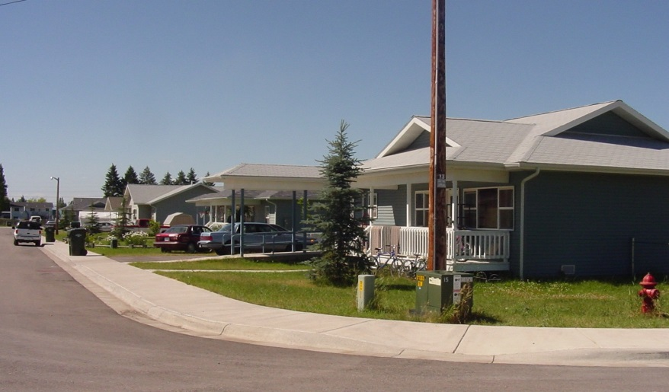
Available Assistance
CSKT member
Buy/down assistance
Closing Cost Assistance
Home$tart
Savings accounts/Individual Deposit Accounts

Slide 11
Downfall
Covenants and Restrictions
Current tenant purchase falls apart
New HTC Qualified applicant
Too high or too little income
Poor credit
METH contamination
Time to ready unit
Homeowners responsibilities
Street cleaning
Sidewalks
Neighbor tension

Slide 12
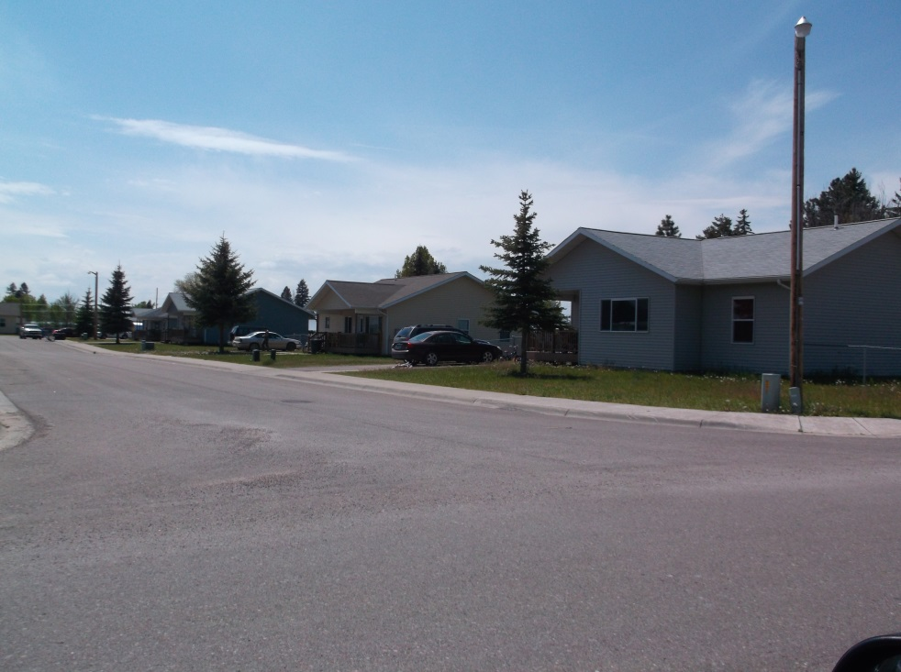
Success Story
Single Mother with teenage son
Minimum wage with very sporadic child support
Had to file Bankruptcy
http://www.charkoosta.com/2014/2014_05_08/Flathead_Finance_student_buys_home.html

Slide 13
contact
Rocki Davis,
Program Compliance/Development Coordinator
rjdavis@skha.org
Nicole Antoine
Homeownership Coordinator
nantoine@skha.org
Salish & Kootenai Housing Authority
PO BOX 38
Pablo, MT 59855
Telephone: 406.675.4491
Fax: 406.675.4495
www.skha.org

