Slide 1



Title
Title Page Content
Bridging the Gap:
Creating Health and Housing Partnerships
Aaron Wernham, MD, MS
CEO, MHCF
www.mthcf.org
info@mthcf.org

Slide 2

Title
Outline of talk
Health in the U.S. and Montana: what’s missing?
Why should community developers and the health sector collaborate?
Examples of collaboration: what is to be gained?
Resources
Title Page Content

Slide 3
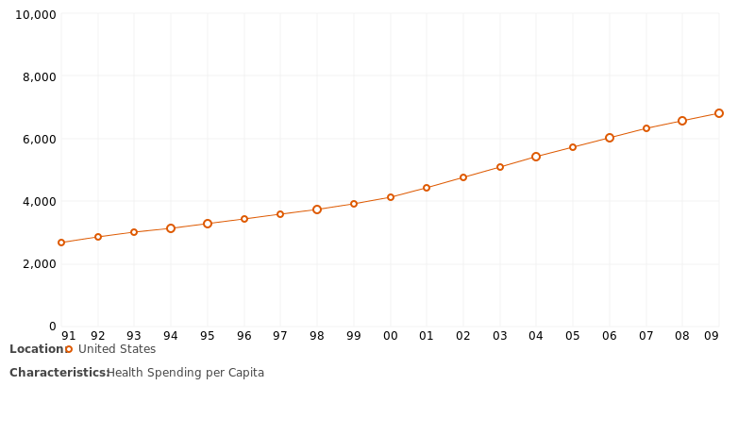
Title
Healthcare spending in the U.S.
$2.9 trillion (2013)
17.4% of GDP
$9,255 per capita
Title Page Content
Source: Kaiser Family Foundation,
http://kff.org/other/state-indicator/health-spending-per-capita/#
Notes:
http://www.cdc.gov/nchs/fastats/health-expenditures.htm

Slide 4
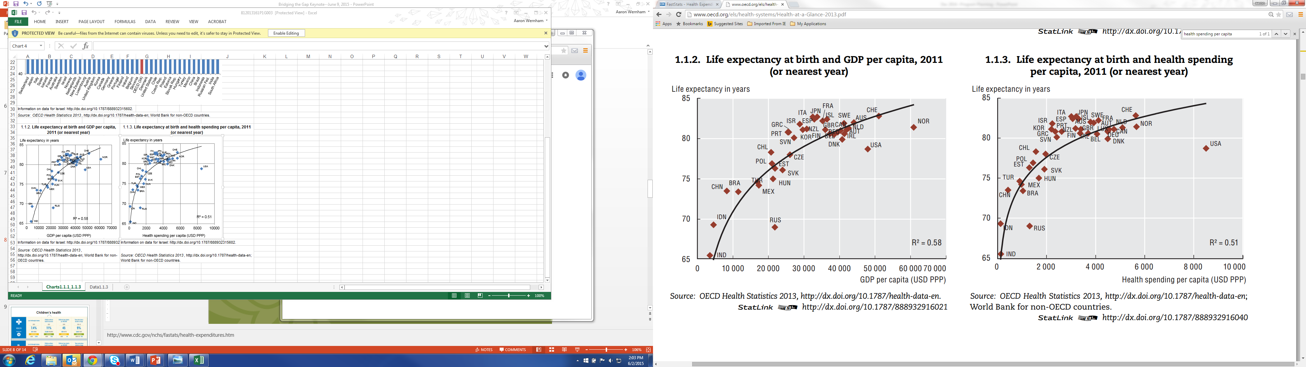
Title
Return on investment?
Title Page Content

Slide 5
Title
Return on investment?
Compared with other developed nations, we fare worse in:
Infant mortality and low birth weight
Injuries and homicides
Adolescent pregnancy and sexually transmitted infections
HIV and AIDS
Drug-related deaths
Obesity and diabetes
Heart disease
Chronic lung disease
Disability
Source: Institute of Medicine 2013, “U.S. Health in International Perspective: Shorter Lives, Poorer Health”
Title Page Content
Notes:
https://www.iom.edu/~/media/Files/Report%20Files/2013/US-Health-International-Perspective/USHealth_Intl_PerspectiveRB.pdf

Slide 6
Title
Why aren’t we healthier if we spend so much on healthcare?
?
Title Page Content
Notes:
http://www.cdc.gov/nchs/fastats/health-expenditures.htm

Slide 7
Title
Healthcare=Health??
Title Page Content
Notes:
http://www.cdc.gov/nchs/fastats/health-expenditures.htm

Slide 8

Title
Let’s go back in time…
Typhus epidemic of Upper Silesia (1847):
14% of the population→20% mortality in 8 months
Typhus was common, so why the epidemic in Upper Silesia at that time?
Rudolph Virchow (“father of modern pathology”) investigated…
Title Page Content

Slide 9
Title
Typhus epidemic of Upper Silesia (1847)
Virchow’s findings?
Typhus didn’t act alone: poverty, poor education, abysmal housing, and poor nutrition were the necessary co-factors that allowed a common pathogen to cause a deadly epidemic.
The cure?
Long-term planning, inter-agency council, free education, reform of the tax system to alleviate poverty, improve economic development.
Title Page Content

Slide 10
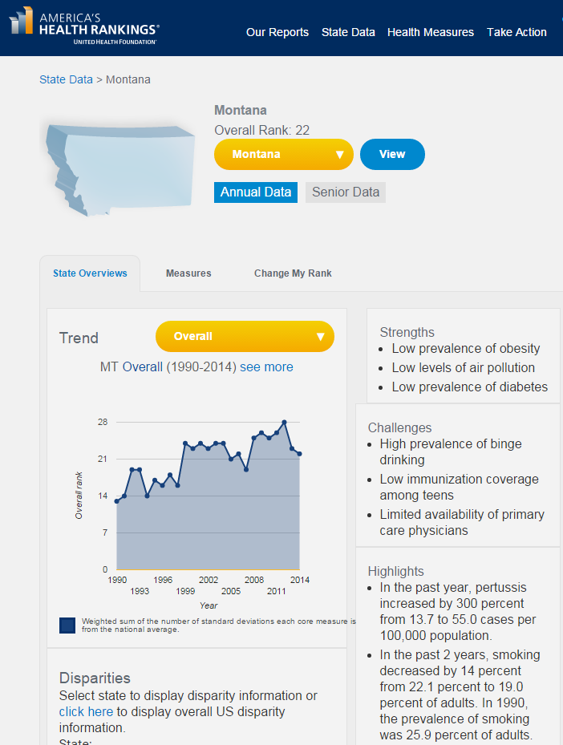

Slide 11
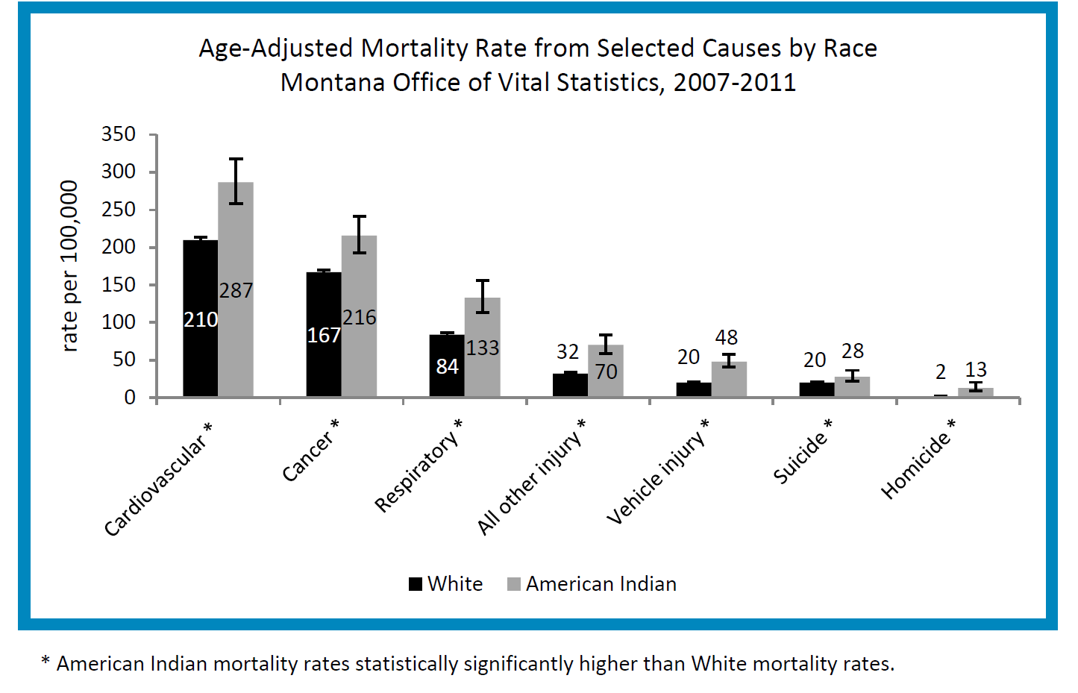
Leading Causes of Death
Notes:
Not spread equally across the population. Here, we see some striking differences according to race.

Slide 12
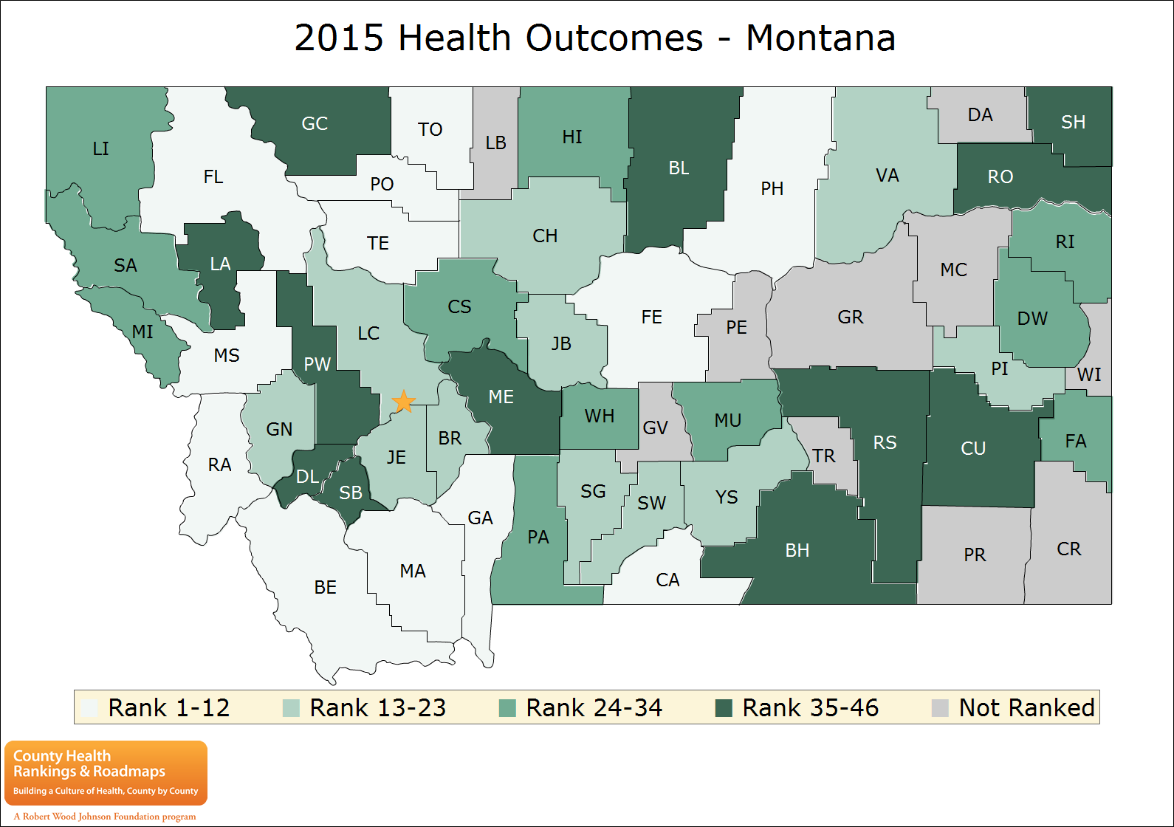
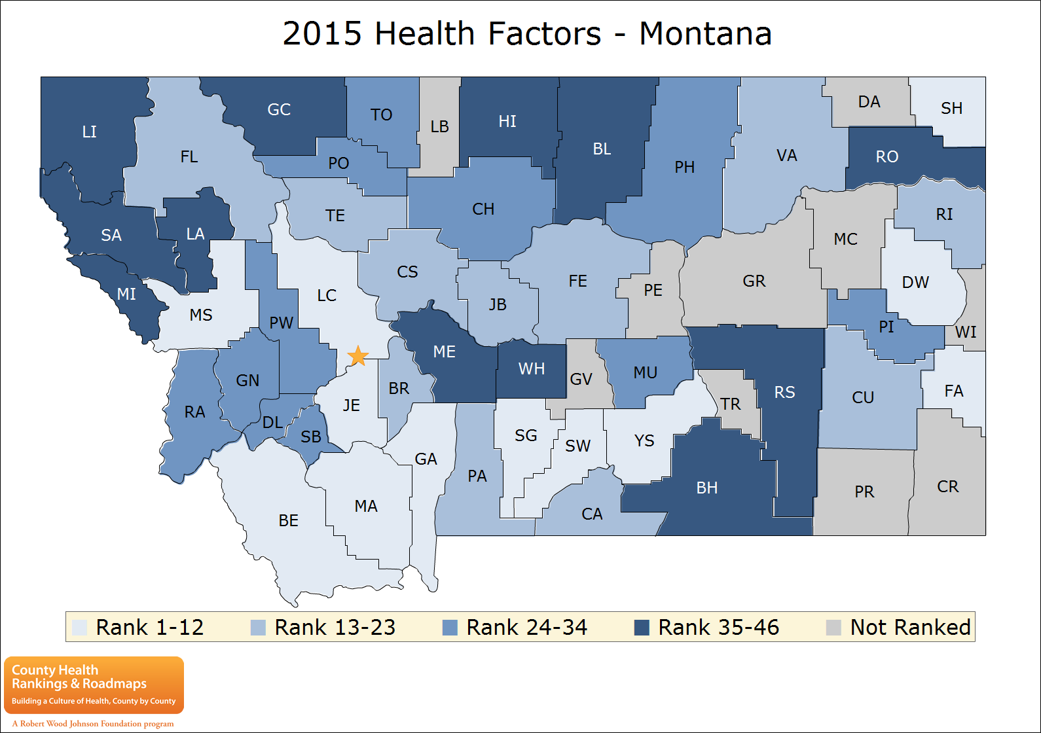
Source:
Robert Wood Johnson Foundation County Health Rankings 2015
www.countyhealthrankings.org
Notes:
Here we see some remarkable geographic variations

Slide 13
Title
 | Gallatin | Glacier
YPLL rate | 4,621 | 14,677
BRFSS “fair to poor health” | 8% | 18%
BRFSS “poor mental health days” | 2.4 | 4.6
LBW | 7% | 8%
Smoking | 13% | 35%
Obesity | 13% | 32%
Heavy drinking | 22% | 21%
Teen birth rate | 15 | 80
Children in poverty | 13% | 38%
Injury death rate | 58 | 133
Title Page Content
Notes:
Rates and source

Slide 14
Title
Health and Income: how does being poor act on a person’s health?
Examples from the Yellowstone County Community Health Assessment
Title Page Content
Notes:
Mention:
Fair to poor health: 6 compared to 35%
Skipped doses of medicine to save money: 5.4 to 31.4%
Depression symptoms: 20 to 42.6%
Domestic violence: 3 times greater
Cant afford healthy food: 2.5 times more likely to report

Slide 15

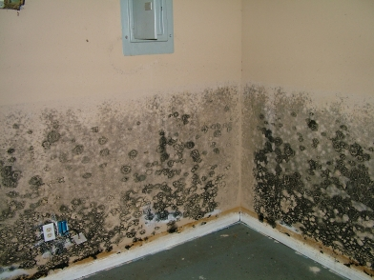
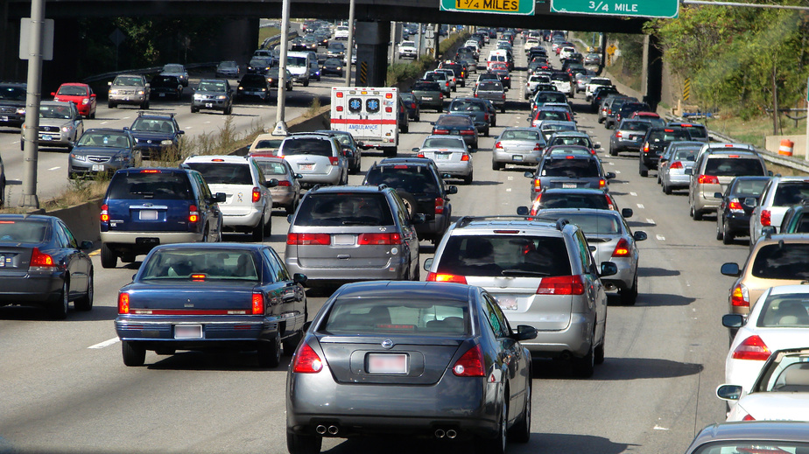
Asthma…
Air Pollution
Housing

Slide 16
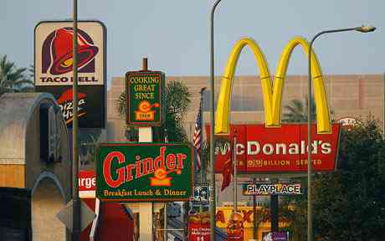
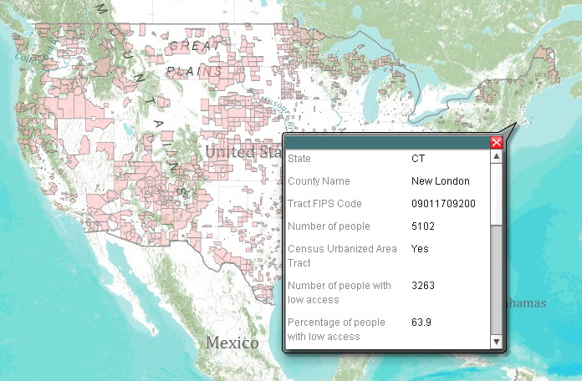
Obesity and Diabetes
Food Deserts
And “food swamps”

Slide 17
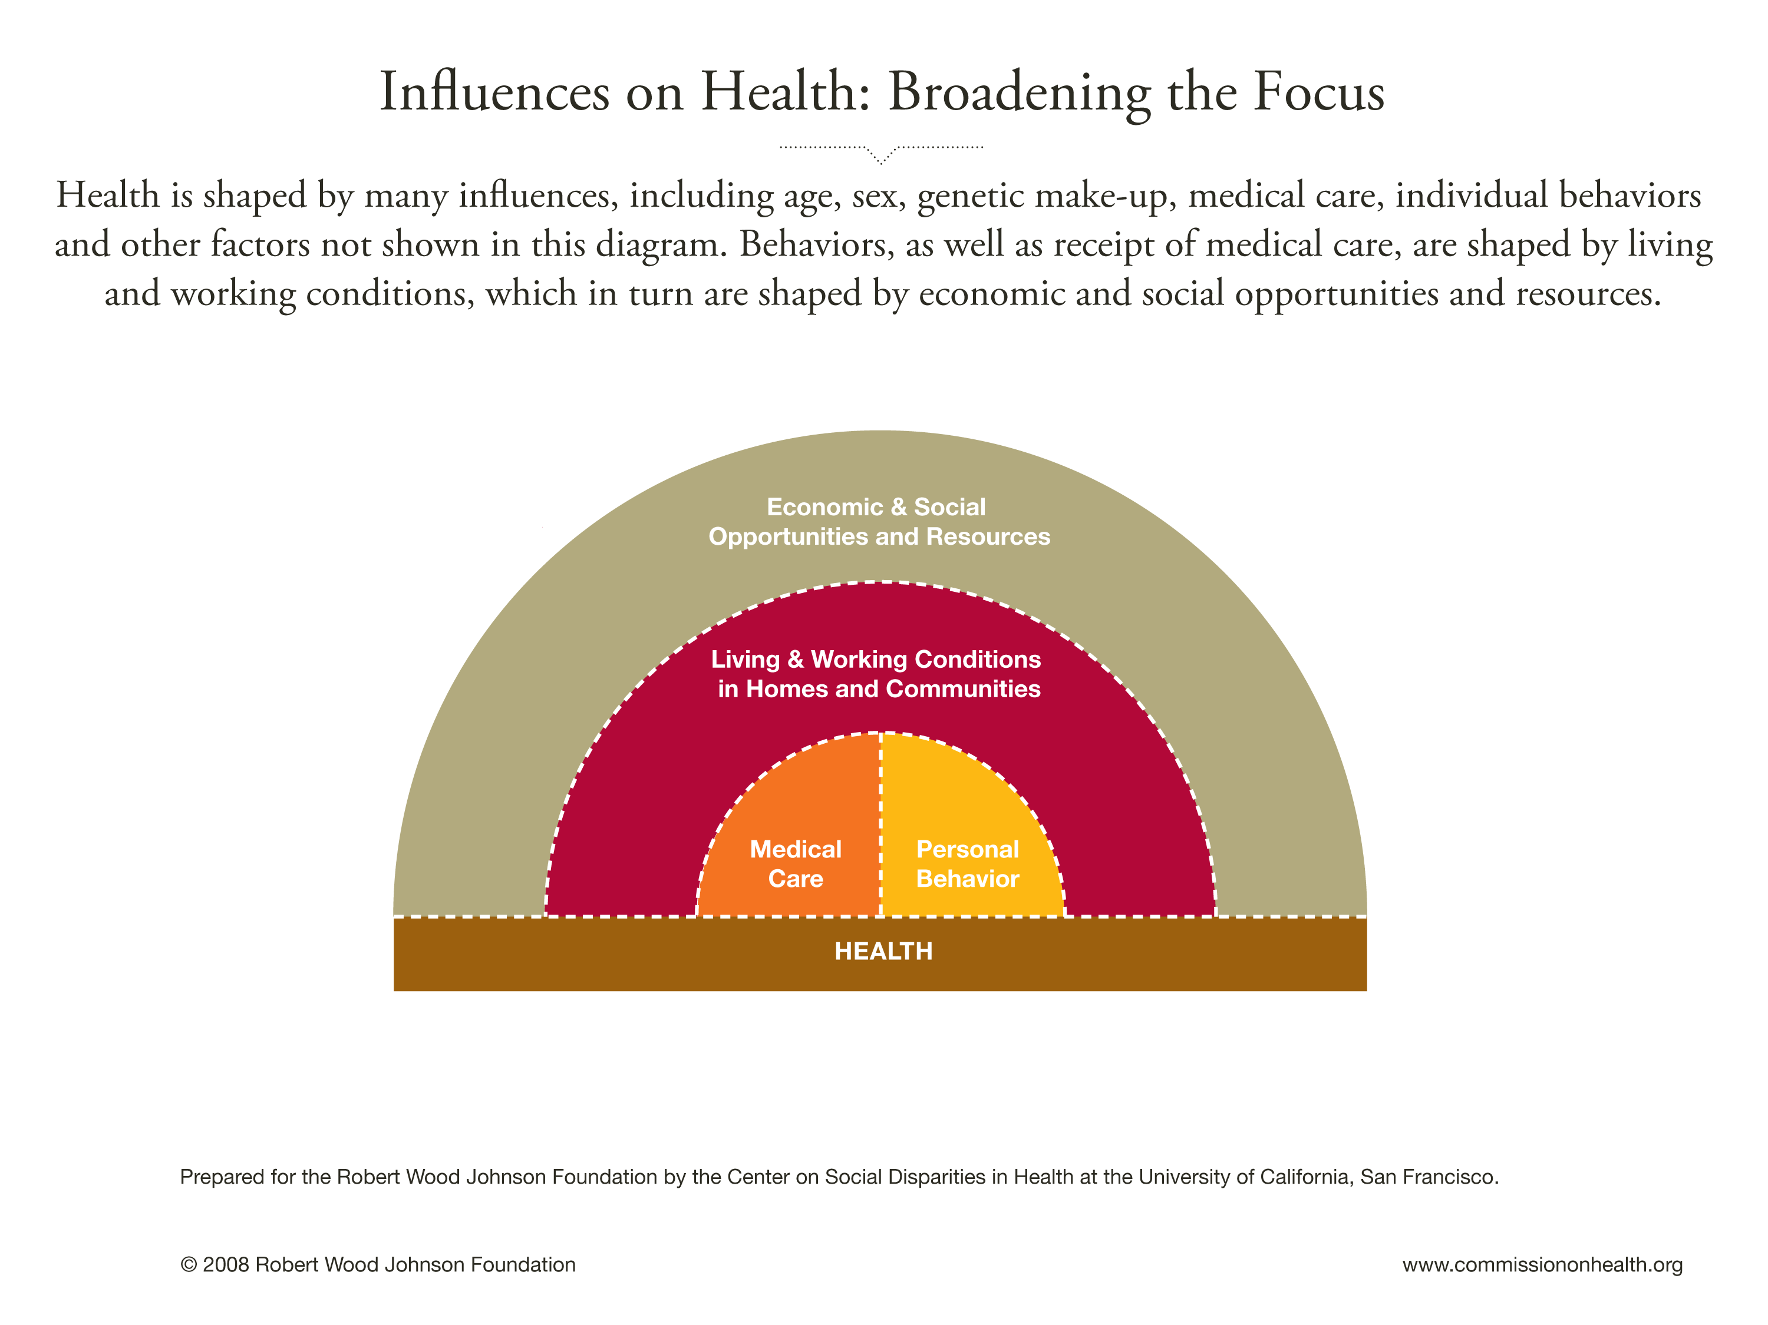
Notes:
The term SDoH really encompasses a wide range of upstream factors that influence health—factors such as employment, income, access to healthy foods and safe places to exercise, housing quality, environmental pollution.
To be sure, this is not a new idea: In the 1800’s for example, Rudolph Virchow, often called the “father of modern pathology,” famously said that “physicians are the natural attorneys for the poor, and social problems fall largely within their jurisdiction.”
So, the recognition that poverty, unsafe working conditions and poor housing can contribute to ill health has been central in some way to prevention and disease control efforts from the beginning. Yet today, healthcare expenditures constitute nearly 20% of all the goods and services in the U.S., yet illnesses such as type two diabetes, asthma, and obesity are still on the rise.

Slide 18
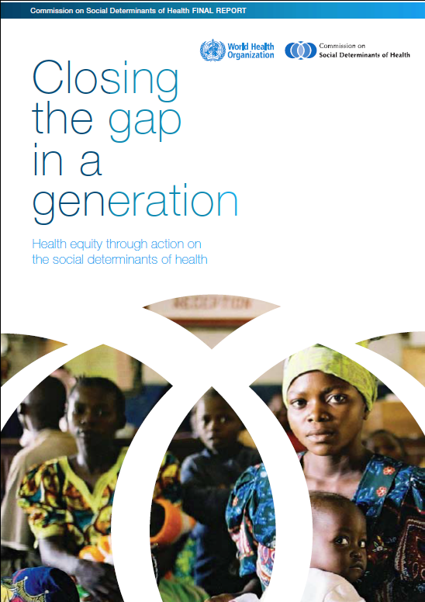
Title
WHO Commission on Social Determinants of Health
Focus on:
  Early childhood
  Healthy places
  Fair and decent employment
  Social protection
  Equity, political empowerment, social inclusion
Title Page Content
http://www.who.int/social_determinants/en/
Notes:
Action on the social determinants of health has become a leading priority for public health internationally. The WHO Commission, which finished this report in 2008, issued a strong call for international action on the SDoH.

Slide 19

Title
World Conference: Rio Political Declaration on Social Determinants of Health
Title Page Content
“Health inequities arise from the societal conditions in which people are born, grow, live, work, and age”
Pledge to promote improved health and health equity by:
Working across different sectors
Implement recommendations of the Commission
Strengthen international collaboration
Empowering the role of communities
Notes:
In 2011, the WHO sponsored a World Conference on SDoH in Rio, which resulted in the adoption of a Political Declaration on the SDoH. Among other things, the report emphasized the need to:

Slide 20
Title
Social Determinants of Health: Healthy People 2020 Indicators
Economic Stability
Poverty, employment, housing stability
Education
High school graduation; higher education
School policies supporting health promotion, safety
Social and Community Context
Social cohesion, discrimination
Civic participation
Incarceration/institutionalization
Health and Health Care
Access to health services
Access to primary care
Health technology
Neighborhood and Build Environment
Quality of housing
Crime and violence
Environmental conditions
Access to healthy foods
Title Page Content
Notes:
Healthy People 2020 represents a very important step toward integrating the SDoH into U.S. public health policy. By adopting a new set of indicators in the areas on this slide, the program has put social, economic, and environmental conditions squarely on the map as an important part of national, state, and local efforts to improve American’s health.

Slide 21
Title
Collaboration between the health and community development sectors:
What are the potential benefits?
  Improving health outcomes
  Improving other social outcomes
  New metrics to demonstrate value of work
  New sources of funding for community development
How can the sectors work together?
What resources are available to support the collaboration?
Title Page Content
Notes:
Benefits:
Optimize health benefits
Advance policies that address mutual aims
Fund projects
How:
Framework for collaboration
Always remember to use a health lens
Form relationships with health depts. and hospitals

Slide 22
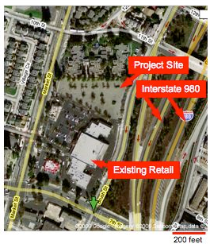
Title
Collaboration:
Health and Community Developers working to address the “social determinants of health”
Jack London Low Income Senior Housing
Proposed housing development: 61 senior housing units near two major freeways and the Port of Oakland.
Title Page Content
Health Risks:
Indoor air quality from outdoor pollution sources (NOT a part of the required permit process) could harm residents
Noise: related to sleep disturbance, high blood pressure
Pedestrian Safety – identified dangerous road crossings
Source: Human Impact Partners, http://www.humanimpact.org/component/jdownloads
Notes:
The best way to explain what HIAs are about is to give some examples. I often start with this one because it is simple, and highlights several important aspects of an HIA.
This HIA was done to inform the design of a proposed low income senior housing building near a major freeway and a large port. It was done as a “rapid” HIA, over less than two months.
The HIA identified several health issues, including:
The risk of poor indoor air quality due to the building’s proximity to major outdoor sources
The risk of sleep disturbance and other health concerns related to noise
The HIA also explored whether the residents of this building would be able to safely walk to local shops and services, and pointed out that some of the intersections might be a bit dangerous for this population.

Slide 23
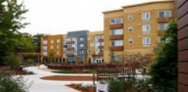
Title
Jack London Project
Outcomes
Title Page Content
Air Quality – developer implemented air filtration; changed windows facing freeway.
Noise – developer added a noise-buffered courtyard and entranceway away from the highway.
Safety – recommendations for “traffic calming” measures (speed bumps, wider sidewalks with narrower lanes, safe cross walks) to allow residents walking access to nearby retail. Under consideration.
Source: http://humanimpact.org/JLG_case_study_draft.pdf
Notes:
Based on these findings, the HIA offered several practical recommendations, including:
Changing the window design from opening balcony windows to sealed bay windows in the units facing the freeway.
Installing particulate filtration
Moving the entryway and installing a noise-buffered courtyard
And measures to slow the speed of traffic and ensure safe crosswalks.
Most of these measures were implemented. A resident of the building summed it up this way:
“The way that they designed this building, it’s for your health. We can open up the air purifiers to get fresh air. I’m even on the side facing the freeway but the building is sound-proof, so you can barely hear the traffic. It’s so peaceful. Before I lived here, I had to have shots for asthma and go to the hospital for oxygen to get my breathing down to the right level. Since I’ve lived here, I haven’t had to do that once. I love it.”

Slide 24
Title
Jack London project:
Now people live there…
Title Page Content
“The way that they designed this building, it’s for your health. We can open up the air purifiers to get fresh air. I’m even on the side facing the freeway but the building is sound-proof, so you can barely hear the traffic. It’s so peaceful. Before I lived here, I had to have shots for asthma and go to the hospital for oxygen to get my breathing down to the right level. Since I’ve lived here, I haven’t had to do that once. I love it.”
Notes:
Based on these findings, the HIA offered several practical recommendations, including:
Changing the window design from opening balcony windows to sealed bay windows in the units facing the freeway.
Installing particulate filtration
Moving the entryway and installing a noise-buffered courtyard
And measures to slow the speed of traffic and ensure safe crosswalks.
Most of these measures were implemented. A resident of the building summed it up this way:
“The way that they designed this building, it’s for your health. We can open up the air purifiers to get fresh air. I’m even on the side facing the freeway but the building is sound-proof, so you can barely hear the traffic. It’s so peaceful. Before I lived here, I had to have shots for asthma and go to the hospital for oxygen to get my breathing down to the right level. Since I’ve lived here, I haven’t had to do that once. I love it.”

Slide 25
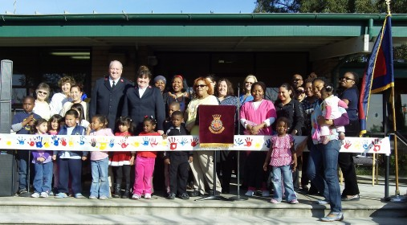
Title
Booth Child Development Center
Project:
LIIF provided a Childcare Facilities Fund improvement grant ($70,000) to a struggling childcare facilitiy.
Old carpet removed→solid floor
Better sinks
Garden to supply school meals
Ramps for changing tables
Outdoor play space
Health-related outcomes:
Substantial reduction in asthma, respiratory
illness,
Improved attendance→revenue
Reduced disability costs among staff
Title Page Content

Slide 26
Title
Housing and Health: a policy example
Policy Question:
Energy prices spiked after Katrina, increasing the financial burden for families. Should LIHEAP funds be increased?
Health Effects:
Pneumonia
Burns
CO poisoning
Hunger and poor nutrition
Recommendations and Outcomes:
Increased funding for LIHEAP—state controller noted the importance of the bill to public health in his evaluation of fiscal impacts
New evaluation parameters to ensure adequate data on outcomes of program
Title Page Content
implications for Medicaid expenditures

Slide 27
Title
Are healthcare dollars a source of funding for community development activities?
New landscape emerging for healthcare: “value-based” payment models being tested: emphasis on improving outcomes rather than simply delivering services
New incentives to ensure that medical care investments improve outcomes: Medicare 30 day readmission penalty; ACOs, Patient Centered Medical Homes, care coordination payments, “hot-spotting”
Hospital community benefit (Schedule H)—establishing stronger standards and eliminating write-offs for “bad debt.”
Title Page Content

Slide 28
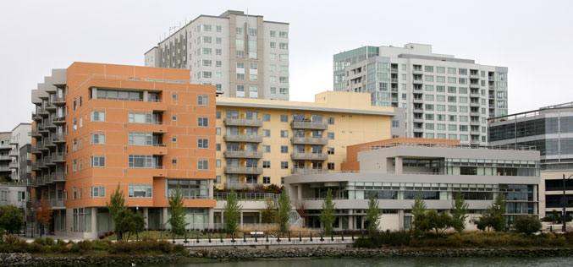
Title
Example: Supportive Housing
Mission Creek Apartments—Mercy Housing
Low-income housing with adult day health program.
Shifted 50 chronically homeless seniors from a city-run nursing home
City estimates it saves $1.45 million/year in nursing home costs and uncompensated care
Title Page Content
https://www.mercyhousing.org/CA-Mission-Creek

Slide 29
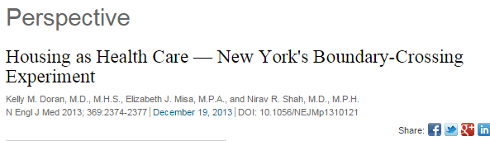
Title
Example: New York’s Medicaid redesign
Targeting high-risk patients, such as homeless frequent utilizers of ER and hospital services
2012-13: $75 million in redesign funds going toward supportive housing
2013-14: $86 million for supportive housing
Why is Medicaid covering this? State plans to recoup costs by reducing costs/improving outcomes among high-cost patients.
Title Page Content

Slide 30
Title
Conclusions:
Medical care is expensive, and social & environmental factors can markedly impact its effectiveness
Increasing medical costs and a trend toward paying for outcomes rather than strictly paying for services are opening the door to a broader and more evidence-driven approach to improving health
New hospital community benefit requirements may allow for financing of come community development/housing projects
New payment models may create an opportunity to finance community development projects that can demonstrate ways to improve health.
Title Page Content

Slide 31
Title
Resources for collaboration
  Publications:
    Fed. Reserve 2013, Investing in What Works for America’s Communities
    Health Affairs Nov. 2014—special issue
      Simplified Framework for Incorporating Health into Community Development Initiatives: Rogerson et. al.
  RWJF Build Healthy Places Network: http://www.buildhealthyplaces.org/
  Social Impact Calculator: http://www.liifund.org/calculator/
  Montana Healthy Communities meeting—stay tuned: join our mailing list at info@mthcf.org.
Title Page Content

