Slide 1


The Fair Housing Act and
Affirmatively Furthering Fair Housing
Tearing Down the Walls Blocking Equal Housing Opportunity
Brick by Brick

Slide 2


The Fair Housing Act and Affirmatively Furthering Fair Housing:
Tearing Down the Walls Blocking Equal Housing Opportunity Brick by Brick
During this training session, we will cover:
BACKGROUND:
Why do the Fair Housing Act and Affirmatively Furthering Fair Housing exist?
Why are recipients required to affirmatively further fair housing?
OVERVIEW OF THE GENERAL PROVISIONS OF THE FAIR HOUSING ACT
THE AFFIRMATIVELY FURTHERING FAIR HOUSING REQUIREMENTS:
For CPD Recipients
For Public Housing Authorities
For Other HUD-Funded Housing Providers
Notes:
We will begin by taking a look at the bricks in the walls blocking equal housing opportunity and the road to removing those bricks…

Slide 3

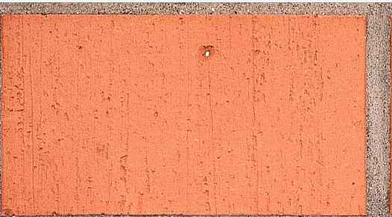




Exclusionary Zoning
SLUMS
SEGREGATION
NIMBYism
All in all, it’s just another brick in the wall…
RACISM
Bigotry
Jim Crow
Separate and Unequal

Slide 4

WALLS BLOCKING FAIR HOUSING…
Fair housing builds the American dream for all through equal housing opportunity. But at one time, fair housing itself was but a dream…

Slide 5
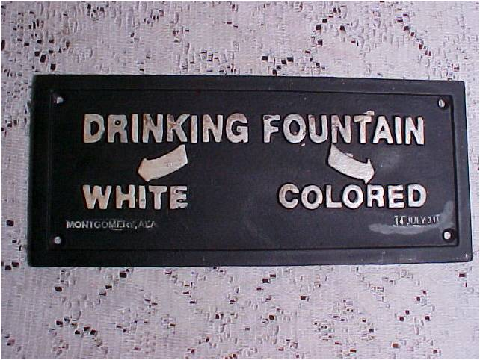
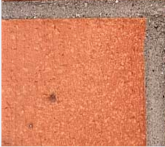

Slide 6
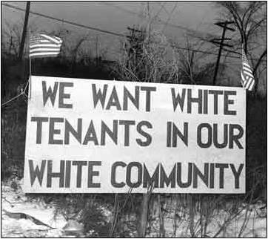


Slide 7


Slide 8
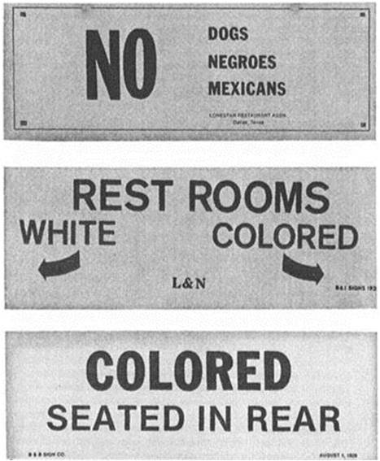

Slide 9



Slide 10


Slide 11



Slide 12

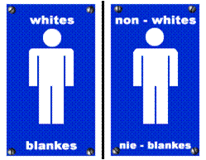



Slide 13
TEARING DOWN THE WALLS BLOCKING EQUAL HOUSING OPPORTUNITY
The dream of fair housing for all Americans is being realized only through the dedication, endurance, and unfailing belief of those who, like Dr. Martin Luther King, Jr., dreamt a dream deeply rooted in the American dream that one day our nation would rise up to live out the true meaning of its creeds that promise equality and the pursuit of happiness for ALL Americans.

Slide 14
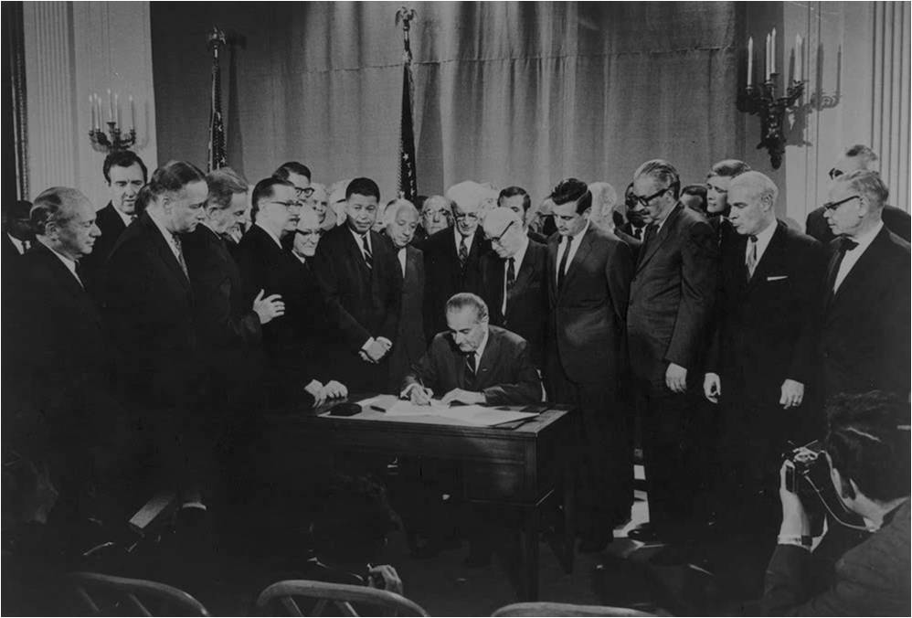
DR. KING’S LEGACY:
A DREAM REALIZED
Notes:
The first person who can tell me what’s happening in this picture gets a prize! President Lyndon B. Johnson signing the Civil Rights Act of 1968 April 11, 1968. The first person who can tell me the significance of this for fair housing gets prize! (Title VIII is the Fair Housing Act!)

Slide 15
PASSAGE OF THE FAIR HOUSING ACT: APRIL 11, 1968
  As predicted by Dr. King himself, the “blood of the martyr” did become “the seed of the
  tabernacle of freedom when he was assassinated on April 4, 1968.
  The Fair Housing Bill had stalled in the Senate when it was introduced, both in 1966 and
  1967. It was up against seemingly insurmountable odds.
  In President Lyndon B. Johnson’s radio address proclaiming April 7, 1968 as a national
  day of mourning, he urged Congress to meet as soon as possible to hear the President’s
  suggestions for immediate action.
  Against what was previously a set of seemingly insurmountable obstacles, the Bill was
  miraculously signed into legislation on April 11, 1968, only seven days after the
  assassination of Martin Luther King, Jr.
Notes:
As we all know, Dr. King led the struggle to pass the fair housing bill.
He worked through the Chicago Freedom Movement to bring media coverage to the problems of housing discrimination and segregation.
He led marches into segregated neighborhoods in the north to bring attention to the fact that segregation, racism, and bigotry were not just southern problems.
During this same time period (1967 – 1968) the casualty list from the Vietnam War was growing – and the death toll fell heaviest on families of poor African Americans and Hispanic Americans.
Veterans of color returned home to a separate and unequal America where they were denied access to jobs, housing, and public services based on their race, color, or national origin.
Senator Edward Brooke (the first African American elected to the Senate by popular vote) and Senator Edward Kennedy argued for the passage of the fair housing bill focusing attention on the impact on veterans of color who served our country.
Notwithstanding their efforts, the bill repeatedly failed.
LBJ’s Kerner Commission showed that the doctrine of “separate but equal” failed and that our society was ever increasingly “separate and unequal.” (National Advisory Commission on Civil Disorders)
When Dr. King was assassinated on April 4, 1968, the country was swept into a profound state of mourning.
Angry riots raged throughout the country.
Cities were burning.
LBJ used this opportunity to re-introduce the bill again - He urged Congress to act in homage to Dr. King and to curtail the civil unrest.
Both the senate and the house passed the bill, unprecedentedly without any debate whatsoever.

Slide 16


THE FAIR HOUSING ACT:
Tearing Down the Walls Brick by Brick
  Prohibits discrimination in the sale, rental, and financing of dwellings.
  Originally prohibited housing discrimination based on race, color, national origin, and religion.
  The Fair Housing Act was amended in 1974 to add sex as a protected class.
  The Fair Housing Amendments Act of 1988:
  Added familial status and disability as protected classes;
  Provided administrative enforcement mechanisms; and
  Provided victims of discrimination with concrete remedies through federal district courts.

Slide 17
THE FAIR HOUSING ACT:
Tearing Down the Walls Brick by Brick, Continued
  The Fair Housing Act prohibits housing discrimination on the bases of:
  Race
  Color
  National Origin
  Religion
  Sex
  Familial Status
  Disability

Slide 18
THE FAIR HOUSING ACT:
Tearing Down the Walls Brick by Brick, Continued
  The federal Fair Housing Act is a floor, NOT a ceiling. Cities, counties, and states throughout the country have fair housing laws that provide greater protections.
DENVER
Military Status
Marital Status
Sexual Orientation
Gender Variance
COLORADO
Creed
Ancestry
Sexual Orientation
Transgender Status
Marital Status
UTAH
Source of Income
NORTH DAKOTA
Age
Status with Respect to Marriage
Receipt of Public Assistance
South Dakota
Ancestry
Creed

Slide 19
THE FAIR HOUSING ACT:
Tearing Down the Walls Brick by Brick, Continued
  Under the Fair Housing Act, the following actions are illegal when taken based on race, color, national origin, sex, religion, familial status, or disability:
  Refusing to sell, rent, negotiate, or otherwise make housing unavailable
  Falsely stating that housing is unavailable
  Providing different services or facilities
  Imposing different terms and conditions (including qualifications, fees, pricing, rules, etc.)
  Advertising or making statements that express a limitation or preference
  Steering, exclusionary zoning, blockbusting, or redlining
  Retaliating against anyone exercising her/his rights under the Fair Housing Act (includes intimidation and coercion)
  Refusing to provide a reasonable accommodation or modification for someone with a disability
Notes:
Blockbusting was a business practice of U.S. real estate agents and building developers meant to encourage white property owners to sell their houses at a loss, by implying that racial minorities were moving into their previously racially segregated neighborhood, thus depressing real estate property values.

Slide 20
THE FAIR HOUSING ACT:
Tearing Down the Walls Brick by Brick, Continued
  Who is covered by the Fair Housing Act? ALL HOUSING PROVIDERS, except:
SINGLE FAMILY HOMEOWNERS
Private individual owners who reside in house
Who own no more than three houses
Who did not use a real estate agent/broker
Still cannot use discriminatory advertising
OWNER-OCCUPIED DWELLINGS
(“MRS. MURPHY)
Containing four or fewer living units
RELIGIOUS ORGANIZATIONS AND PRIVATE CLUBS
HOUSING FOR OLDER PERSONS THAT MEETS HOPA

Slide 21
AFFIRMATIVELY FURTHERING FAIR HOUSING (AFFH)
Knocking Down the Remaining Bricks

Slide 22
AFFIRMATIVELY FURTHERING FAIR HOUSING (AFFH) :
Knocking Down the Remaining Bricks
Section 808(d) of the Fair Housing Act
Provides that all executive departments and agencies shall administer their programs and
activities relating to housing and urban development (including any Federal agency having
regulatory or supervisory authority over financial institutions) in a manner affirmatively to
further the purposes of the Act and shall cooperate with the Secretary of Housing and
Urban Development to further such purposes.
Section 808(e)(5) of the Fair Housing Act
  Requires the Secretary of HUD to ensure that all HUD programs affirmatively further fair housing and affirmatively further the policies of the Fair Housing Act.
Executive Order 12892, as Amended (1994)
  Requires federal agencies to affirmatively further fair housing in their programs and activities, and provides that the Secretary of HUD will be responsible for coordinating the effort.
Notes:
You have probably noticed the remaining stubborn bricks at the bottom of our slides. These represent the remaining areas of segregation, the remaining inequality, the remaining impediments to housing choice that still exist for people in protected classes throughout the country. These are the legacies of the doctrine of separate and unequal.

Slide 23
AFFIRMATIVELY FURTHERING FAIR HOUSING (AFFH) :
Knocking Down the Remaining Bricks
AFFH Requirements for CPD Recipients
  Three-Pronged AFFH Certification [24 C.F.R. § 570.61 (a)(2) (2010)]
  CPD recipients certify annually that they will affirmatively further fair housing by:
  1) Conducting an analysis to identify impediments to fair
  housing choice within the jurisdiction;
  2) Taking appropriate actions to overcome the effects of any impediments
  identified through that analysis; and
  3) Maintaining records reflecting the analysis and actions in this regard.
Notes:
Have any of you seen the movie, Elysium? FHEO regs and the CPD implementing regs for various programs (CDBG, HOME, etc.) address the Secretary’s AFFH obligations by requiring all CPD grantees to sign the three-pronged AFFH certification. CPD grantees sign the AFFH Certification annually at the time they submit their Annual Action Plans.

Slide 24
AFFH Requirements for CPD Recipients, Cont.
  AFFH Step 1: Conducting an Analysis to Identify Impediments
  ANALYSIS OF IMPEDIMENTS TO FAIR HOUSING CHOICE (AI)
  An AI identifies:
  Actions, omissions, or decisions taken because of one of the protected classes that restrict housing choice or availability for people in protected classes; and
  Any actions, omissions, or decisions that have the effect of restricting housing choices or availability for people in protected classes.

Slide 25
AFFH Requirements for CPD Recipients
Step 1: Conducting an Analysis to Identify Impediments, Cont.
  Essential Elements of an AI
  A complete review of the laws, regulations, administrative policies, procedures, and practices;
  An assessment of how those laws, regulations, administrative policies, procedures, and practices affect the location, availability, and accessibility of housing;
  An assessment of conditions, both public and private, affecting housing choice for people in all protected classes; and
  An assessment of the availability of affordable, accessible housing in a range of unit sizes.

Slide 26
AFFH Requirements for CPD Recipients
Step 1: Conducting an Analysis to Identify Impediments, Cont.
  An Effective AI:
  Analyzes the appropriate data:
  - The zoning codes, local regulations, public policies, economic and housing
  circumstances, conditions, etc. that exist within the jurisdiction
  - Demographic and geographic data for the individual jurisdiction
  Utilizes current data and analyze current conditions:
  - According to HUD guidelines, should conduct AIs at least once every three-
  to-five years (consistent with the Consolidated Planning cycle, if feasible)
  Avoids confusing barriers to affordable housing with impediments to fair housing choice:
  - BARRIER TO AFFORDABLE HOUSING: Blocks housing choice on an equal
  opportunity basis
  - IMPEDIMENT TO FAIR HOUSING CHOICE: Specifically blocks housing choice
  for people in protected classes
  - A BARRIER TO AFFORDABLE HOUSING THAT IS ALSO AN IMPEDIMENT TO
  FAIR HOUSING CHOICE: Disproportionately blocks housing choice for
  people in protected classes
Notes:
Equal opportunity barriers versus walls that block housing opportunity specifically for people in protected classes through disproportionate impact. Condition or circumstance. For barriers to affordable housing that are also impediments to housing choice, there must be an analysis that explains the disproportionate impact.

Slide 27
AFFH Requirements for CPD Recipients
Step 1: Conducting an Analysis to Identify Impediments
An Effective AI, Continued
  Relies primarily on quantitative data:
  - Avoids drawing conclusions based on public opinion, perception, or purely
  anecdotal evidence
  Uses reliable data sources:
  - U.S. Census Bureau (American Fact Finder)
  - Mapping sites that provide information about segregated areas
  - HUD Data Sets
  - Data sets that pinpoint where subsidized housing is located
  - Local information about zoning and other housing-related policies and
  practices
Notes:
Mixed metro, Brown University,

Slide 28
AFFH Requirements for CPD Recipients
Step 1: Conducting an Analysis to Identify Impediments
An Effective AI, Continued
  Pinpoints circumstances that have the unintended side effect of blocking housing choice for people in protected classes:
  - Not primarily about identifying overt discrimination or obvious
  discriminatory practices, unless there is data supporting the presence of
  systemic discrimination or institutionalized discriminatory practices
  Uncovers impediments that recipients have the power and mechanisms to address:
  - Not primarily about determining the number of fair housing complaints
  against private housing providers
Notes:
Mixed metro, Brown University,

Slide 29
AFFH Requirements for CPD Recipients
Step 1: Conducting an Analysis to Identify Impediments
An Effective AI, Continued
  Reveals the circumstances that impact housing choice so that jurisdictions may act affirmatively to overcome the effects of those circumstances:
  - Complying with other fair housing and civil rights requirements is NOT
  affirmatively furthering fair housing. Affirmatively furthering fair housing
  means more than simply refraining from discriminating.
  Identifies impediments that uniquely impact housing choice for protected classes within the geographic boundaries of a recipient’s jurisdiction
Notes:
Mixed metro, Brown University,

Slide 30
AFFH Requirements for CPD Recipients
Step 1: Conducting an Analysis to Identify Impediments, Cont.
  Six Core Components of an AI
  1) Segregation and Integration
  2) Racially and Ethnically Concentrated Areas of Poverty (RCAP/ECAP)
  3) Access to Opportunity
  4) Fair Housing Environment
  5) Infrastructure Investments
  6) Public Participation

Slide 31
AFFH Requirements for CPD Recipients
Step 1: Conducting an Analysis to Identify Impediments,
Six Core Components of an AI, Continued
  ADDRESS AREAS OF SEGREGATION AND INTEGRATION.
  Identify patterns/areas of segregation at the Census tract/neighborhood level.
  Use a dissimilarity index and CPD mapping tool to illustrate segregation: http://egis.hud.gov/cpdmaps.
  If pockets of segregation exist, determine why.
  - Examine local laws, public policies, regulations, or ordinances that may
  restrict housing choice for protected classes.
  - Analyze factors that create or perpetuate segregation.
  Identify the current barriers to reducing segregation.

Slide 32
AFFH Requirements for CPD Recipients
Step 1: Conducting an Analysis to Identify Impediments,
Six Core Components of an AI, Continued
  ADDRESS RACIALLY AND ETHNICALLY CONCENTRATED AREAS OF POVERTY(RCAP/ECAP).
  Determine the percentage of RCAP/ECAP Census tracts in the jurisdiction for each protected class group.
  Compare the characteristics of RCAPs and ECAPs with non-concentrated areas of the jurisdiction. What are the differences in…
  - Access to opportunity?
  - Infrastructure?
  - Access to services, grocery stores, health care, jobs, libraries, education?
  - Public transportation?
  - Environment?
  - Green areas, parks, recreation, walkable sidewalks?
  - School quality: Public schools report cards
  Examine the types of housing opportunities in RCAPs and ECAPs.
Notes:
Infrastructure: Water, sewer, streets, sidewalks, street lights, accessibility for PWDs.

Slide 33
AFFH Requirements for CPD Recipients
Step 1: Conducting an Analysis to Identify Impediments,
Six Core Components of an AI, Continued
  ADDRESS ACCESS TO EXISTING AREAS OF OPPORTUNITY.
  Identify the areas/neighborhoods that contain opportunity indicators.
  - Above average schools: See school report cards for school districts.
  - Access to employment, grocery stores, health care, retail, public
  transportation, green spaces, low crime rate, infrastructure, libraries
  Identify areas of opportunity where affordable, accessible, or needed housing options are lacking.
  - Multifamily housing that serves larger families
  - Accessible housing for people with disabilities
  - A variety of housing options for people with diverse income levels
  What factors are contributing to segregation, the presence of RCAPs/ECAPs,
  and the lack of a variety of housing options in areas of opportunity?
Notes:
SCHOOL EQUALITY: What do Colorado and (I think) also Utah have that is an action that potentially overcomes impediments to housing choice?

Slide 34
AFFH Requirements for CPD Recipients
Step 1: Conducting an Analysis to Identify Impediments,
Six Core Components of an AI, Continued
  POTENTIAL FACTORS THAT CREATE OR PERPETUATE SEGREGATION, INCLUDING RCAPs AND ECAPs, AND LIMIT HOUSING OPTIONS IN AREAS OF OPPORTUNITY
  Housing Citing Decisions
  Actions by Decision Makers
  Community Opposition
  Zoning and Land Use Laws
  A Lack of Housing Choices for Larger Families or People with Disabilities
  A lack of Housing Options in a Range of Pricing
Notes:
Anything that restricts the development of affordable housing, public housing, multifamily housing, or housing for people with disabilities. Discuss schools and the role of school location in impacting housing choice.

Slide 35
AFFH Requirements for CPD Recipients
Step 1: Conducting an Analysis to Identify Impediments,
Six Core Components of an AI, Continued
  POTENTIAL FACTORS THAT CREATE OR PERPETUATE SEGREGATION, INCLUDING RCAPs and ECAPs, AND LIMIT HOUSING OPTIONS IN AREAS OF OPPORTUNITY, CONTINUED
  School Enrollment
  Systemic Discrimination
  Steering
Notes:
Anything that restricts the development of affordable housing, public housing, multifamily housing, or housing for people with disabilities. Discuss schools and the role of school location in impacting housing choice.

Slide 36
AFFH Requirements for CPD Recipients
Step 1: Conducting an Analysis to Identify Impediments,
Six Core Components of an AI, Continued
  POTENTIAL FACTORS THAT CREATE OR PERPETUATE SEGREGATION, INCLUDING RCAPs and ECAPs AND LIMIT HOUSING OPTIONS IN AREAS OF OPPORTUNITY, CONTINUED
  Land or Development Cost Barriers
  Lack of Code Enforcement
  Local Residency Preference or Other PHA Preference Systems
  Land Availability
  Lack of Housing Choice Voucher Opportunities that Concentrate Members of Protected Classes:
  - Source of income discrimination
  - A lack of accessible housing for people with mobility disabilities
  - PHA residency restrictions or preference systems
Notes:
Anything that restricts the development of affordable housing, public housing, multifamily housing, or housing for people with disabilities. Discuss schools and the role of school location in impacting housing choice.

Slide 37
AFFH Requirements for CPD Recipients
Step 1: Conducting an Analysis to Identify Impediments,
Six Core Components of an AI, Continued
  ADDRESS THE FAIR HOUSING ENVIRONMENT.
  Is there evidence of systemic discrimination?
  Are there open findings of discrimination involving the jurisdiction, a local PHA, recipient, or subrecipient?
  Are there local fair housing enforcement mechanisms?
  - Local or state fair housing law(s)
  - Agencies that enforce local civil rights laws
  Are there fair housing education opportunities for employees of recipients and subrecipients, local PHAs, members of the public, and housing providers?
  Are there local fair housing organizations?
  Are there opportunities for collaboration?
  What is public policy about addressing civil rights violations, systemic discrimination, community opposition, etc.?
Notes:
For local fair housing ordinances, your AI should address impediments to housing choice for other protected classes (i.e., sexual orientation, transgender status, marital status, source of income, etc.)

Slide 38
AFFH Requirements for CPD Recipients
Step 1: Conducting an Analysis to Identify Impediments,
Six Core Components of an AI, Continued
  ADDRESS INFRASTRUCTURE IMPROVEMENTS/EXPENDITURES.
  Transportation
  - Evaluate the location of public transportation system service areas
  - Transportation costs
  - Commute times to employment opportunities
  - What are the local challenges?
  Economic Development and Revitalization
  - Where are large investments targeted?
  - Will planned investments reduce segregation and increase access to areas of
  opportunity?
  Sustainable, Walkable Community Indiators
  - TOD Indicators
Notes:
HOLISTIC APPROACH

Slide 39
AFFH Requirements for CPD Recipients
Step 1: Conducting an Analysis to Identify Impediments,
Six Core Components of an AI, Continued
  PUBLIC PARTICIPATION PROCESS
  Engage and consult with key players during the AI process:
  State and local government agencies involved in fair housing enforcement, housing, and community revitalization
  Private fair housing groups
  PHAs
  Affordable housing developers and providers
  Civil rights groups
  Immigrant-focused organizations
  Disability advocacy organizations
  Other groups representing minority populations (i.e., LEP persons)
  Housing providers (i.e., realtors, lenders, apartment associations, etc.)
  Public opinion survey results:
  - Can be used as a beginning point to form hypotheses.
  - Should never be used as the sole basis to identify impediments.
Notes:
This does not mean to survey opinions about fair housing and use the results to identify impediments. Publish a draft version of your AI for public review and comment. Target your advertising about the AI to ensure the information reaches those least likely to hear about it. Take affirmative efforts to reach people in protected class groups.

Slide 40
AFFH Requirements for CPD Recipients , Continued
  AFFH Step 2: Taking Actions to Overcome the Effects of Impediments
  AFFH PLANNING
  Utilize the AI for program planning using the consolidated planning process!
  - Create long term action plan using the five-year consolidated plan.
  - Plan specific annual actions to address impediments through annual action
  plans.
  - Set realistic AFFH goals.
  Plan specific AFFH actions:
  - What? Who? When? Where?
  - Specify money or resources required to implement actions
  - Set specific measurable goals.
  Use a holistic approach:
  - Educate stakeholders about the AI and identified impediments.
  - Include key players in the planning process.
  - Draw connections between planned program year activities, impediments,
  and actions to overcome.
  - Collaborate with local fair housing organizations.
Notes:
Planned actions should connect directly to identified impediments! Key staff members, subrecipients, institutional structure, etc.

Slide 41
AFFH Requirements for CPD Recipients , Continued
  AFFH Step 2: Taking Actions to Overcome the Effects of Impediments
  Implementing Specific Concrete Actions that Overcome the Effects of Impediments
  Actions must specifically address identified impediments that disproportionately impact housing choice for people based on one or more of the protected classes:
  - EXAMPLES: Zoning laws and policies; community resistance to certain types
  of housing (NIMBYism); geographic targeting of recipient housing programs;
  location of housing that is available and accessible to people in protected
  classes, etc.
  General fair housing activities are not actions to overcome the effects of impediments to fair housing choice!
  - Providing fair housing education and outreach: If identifying a lack of fair
  , housing education as an impediment, the AI must make a direct connection
  between a lack of education and housing choice for people in one or more of
  the protected classes.
Notes:
Let’s talk about NIMBYism… What actions might a jurisdiction take to address community resistance to housing for people with disabilities?

Slide 42
AFFH Requirements for CPD Recipients , Continued
  AFFH Step 3: Maintaining AFFH Records
  Document all AFFH plans and actions within HUD submissions:
  - ConPlans: Document long term action plans
  - Annual Action Plans: Document specific annual actions planned
  - CAPERs: Document actions implemented to overcome the effects of
  impediments and include measurable outcomes for people in protected
  classes
  Document the amount of funding allocated and disbursed for AFFH actions.
  Maintain records that establish the connections between identified
  impediments, established priority housing needs, funded activities, and
  actions to affirmatively further fair housing.
Notes:
Planned actions should connect directly to identified impediments! Key staff members, subrecipients, institutional structure, etc.

Slide 43
AFFIRMATIVELY FURTHERING FAIR HOUSING (AFFH) :
Knocking Down the Remaining Bricks
AFFH Requirements for PHAs
  Five-Pronged AFFH Certification
  [24 C.F.R. § § 1.4, 960.103(b), and 903.7(o)]
  PHA recipients certify annually to affirmatively further fair housing by:
  1) Examining programs or proposed programs;
  2) Identifying any impediments to fair housing choice within those programs;
  3) Addressing those impediments in a reasonable fashion in view of the
  resources available;
  4) Working with local jurisdictions to implement any of the jurisdiction’s
  initiatives to affirmatively further fair housing; and
  5) Maintaining records reflecting these analyses and actions.
Notes:
Public housing authorities certify annually they will affirmatively further fair housing within their PHA Plans.

Slide 44
AFFIRMATIVELY FURTHERING FAIR HOUSING (AFFH) :
Knocking Down the Remaining Bricks
AFFH Requirements for PHAs, Continued
  AFFIRMATIVELY FURTHERING FAIR HOUSING IN PHA PROGRAMS
  Utilize the local jurisdiction’s AI as a starting place.
  - What are the impediments identified within the jurisdiction?
  Examine PHA programs and policies:
  - ACOP
  - Administrative Plans
  - Preference Systems
  - Occupancy Requirements
  - Designated Housing Plans
  Examine PHA waiting lists and occupancy data alongside local demographic
  data for protected class groups.
  - Are there any under-represented groups?
  - Is there a lack of mobility accessible units for people who need them?
Notes:
Do any of the PHA’s policies, preference systems, occupancy standards, etc. contradict the jurisdiction’s identified impediments? Provide examples. Ensure that the PHA is following all fair housing and civil rights requirement and is maintaining all required policies to comply with Section 504 and Title VI. Ensure that none of the PHA’s policies contradict any fair housing and civil rights requirements. Provide examples.

Slide 45
AFFIRMATIVELY FURTHERING FAIR HOUSING (AFFH) :
Knocking Down the Remaining Bricks
AFFH Requirements for PHAs, Continued
  AFFIRMATIVELY FURTHERING FAIR HOUSING IN PHA PROGRAMS
  Identify Impediments
  Take Actions to Address Impediments:
  - Modify policies, preference systems, designations, occupancy requirements,
  etc. that oppose the jurisdiction’s AFFH planning efforts.
  - Amend preference systems and other program policies to assist the
  jurisdiction in its efforts to affirmatively further.
  - Ensure that all public housing developments have at least 5% units that are
  accessible for people with mobility disabilities. (Section 504 requirement)
  Maintain Records
  - Utilize PHA Plans for AFFH recordkeeping.
  - Maintain an internal AFFH file for recordkeeping.
  - Report AFFH efforts to local jurisdictions: Collaborate!
Notes:
Ask the group to brainstorm potential impediments to housing choice that might exist in PHA programs. Write on flipchart.

Slide 46
AFFIRMATIVELY FURTHERING FAIR HOUSING (AFFH) :
Knocking Down the Remaining Bricks
AFFH Requirements for Other HUD Recipients
  AFFIRMATIVE MARKETING
  Identify those protected class groups least likely to apply for housing
  opportunities:
  - Compare waiting list and occupancy data to local demographic data
  Develop an affirmative fair housing marketing plan designed to reach those
  groups least likely to apply through:
  - Properly placed advertising
  - Community outreach
  - Collaboration with organizations associated with specific protected class
  groups
Notes:
All HUD funded housing programs should analyze participation to ensure no groups are under-represented. FHA-insured multifamily housing (both subsidized and unsubsidized) complete Affirmative Fair Housing Marketing Plans (AFHMPs) and must submit these to HUD using a HUD 9352a.) But all HUD funded housing programs are required to affirmatively market housing programs to reach those under-represented groups.

Slide 47
AFFIRMATIVELY FURTHERING FAIR HOUSING (AFFH) :
Knocking Down the Remaining Bricks
AFFH Compliance Reviews
  FHEO assesses risk analysis to select recipients for compliance reviews.
  - Based on a review of AFFH reporting in HUD submissions
  - Based on information about AFFH issues, findings, court proceedings,
  conclusions of a lawsuits, court decisions, etc.
  - Based on a Fair Housing Act complaint that raises AFFH issues
  - Based on local news stories about community opposition, zoning, failure to
  waive zoning requirements as reasonable accommodations for group
  homes, etc.
  Compliance reviews reveal the presence of any evidence that a recipient failed to act affirmatively to further fair housing:
  - Did the recipient fulfill the three prongs of the AFFH Certification by
  conducting a substantially complete AI; taking appropriate actions to
  overcome the effects of any identified impediments; and maintaining AFFH
  records?

Slide 48
AFFIRMATIVELY FURTHERING FAIR HOUSING (AFFH) :
Knocking Down the Remaining Bricks
AFFH Compliance Reviews, Continued
  The Fair Housing Act imposes an affirmative obligation by requiring recipients to do something “more than simply refrain from discriminating themselves or purposely aiding discrimination by others.”
  HUD has interpreted the affirmative obligations of the Fair Housing Act to mean that recipients must:
  - Analyze and eliminate housing discrimination in the jurisdiction;
  - Promote fair housing choice for all persons;
  - Provide opportunities for inclusive patterns of housing occupancy, regardless
  of race, color, national origin, religion, sex, familial status, or disability;
  - Promote housing that is structurally accessible to, and usable by, people
  with disabilities; and
  - Foster compliance with the nondiscrimination provisions of the Fair Housing
  Act.

Slide 49

Tearing Down the Walls through
Fair Housing and Equal Opportunity
And now introducing a new removal tool that is 45 years in the making…

Slide 50
AFFIRMATIVELY FURTHERING FAIR HOUSING (AFFH) :
Knocking Down the Remaining Bricks
Publication of a Proposed AFFH Rule
  Published July 19, 2013
  Expected to become Final this Fall!
Notes:
The takeaway today is that, as you have learned throughout this session, the AFFH requirements have existed since 1968 within the Fair Housing Act. AFFH is not a new HUD policy. This will just be a written regulation that will provide concrete guidance for implementing the Law and meeting the AFFH requirement.

Slide 51
QUESTIONS?

Slide 52
For more information, contact:
Michele Hutchins, Equal Opportunity Specialist
Office of Fair Housing & Equal Opportunity
U.S. Department of Housing & Urban Development
125 S. State Street, Room 3001
Salt Lake City, UT 84138
(801) 524-6097-Direct line
(801) 524-6909-TDD/TTY line
1-800-877-7353 – Denver Toll Free
email: michele.hutchins@hud.gov

